Slide 1
Building a Positive Organizational Culture

Slide 2
Session Overview
Organizational Culture: what and why?
The Englewood Journey
Assessing the culture
Engaging staff
Creating a plan
Seeking professional help
Maintaining and continuously improving

Slide 3
What makes a good organizational culture?

Slide 4
Keys to a healthy…
6

Slide 5
Leadership
Sense
of
Purpose
People
Communication
Trust
& Accountability
Recognition & Appreciation
Elements of…
7

Slide 6
CULTURE STRATEGY
T

Slide 7
Facilitates strong team environment
Improves productivity
Decreases turnover
Increases employee engagement
Recruits and retains top performers
Creates strong brand identity
T

Slide 8
Assessing the Culture

Slide 9
CULTURE: Where we were
My experience
Anxious & under fire
Yelling and dressing down
Cliques & favorites
Lack of recognition
Silo’d (but less than other cities)

Slide 10
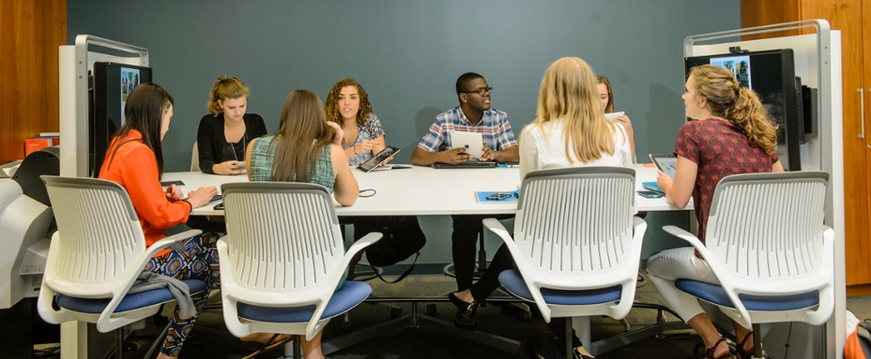
Assessing the Culture
2019 Focus Groups
One focus group per department
What do you love about the City of Englewood as an organization?
If you had a magic wand, what would you change about our organization?

Slide 11
Turning Feedback into a S/W Analysis
Pitfalls:
Synthesizing info was very time consuming
Should’ve split boards and commissions from staff

Slide 12
Engaging Staff

Slide 13
Engaging Staff to Create Solutions
2020 Staff Task Forces
Directors co-led one-year staff task forces
Cross Training & Departmental Coordination
Diversity & Inclusion
Community Engagement
Training & Development
Employee Recognition
50 staff volunteered to serve

Slide 14
Creating a Plan
T

Slide 15
Turning Recommendations into a Plan
Recommendations from Task Forces became Blueprint for Organizational Success in 2021
Blueprint become “Governance” outcome area of Strategic Plan in 2022
Pro: Engaged Council in organizational improvement
Con: Council turnover led to opposition of some Blueprint goals
T

Slide 16
Seeking Professional Help

Slide 17
Culture Focused Supervisory Training
CCCMA 2021—”Happy Employees are Great Employees” by Kris Boesch
4-hour sessions required for all supervisors in cohorts by level for 11 months around Known Matter Included by Choose People ©
Self-awareness
Prioritizing and avoiding overwhelm
Creating psychological safety
Empowering accountability (performance management)
Recognition and celebration
Facilitating good decisions and good meetings
Building your team
Having kind, candid and constructive communication
Resolving conflict
Living our mission, vision, values

Slide 18
Culture-Focused Training
Pros: Baseline of expectations for all supervisors, shared language and terminology, longevity of concepts, weeded out some supervisors, negotiated rights to record and reuse materials
Cons: $75K, some resented mandatory nature, followed hot topics (i.e. burnout and overwhelm), may have swung pendulum too far to relationships over performance

Slide 19
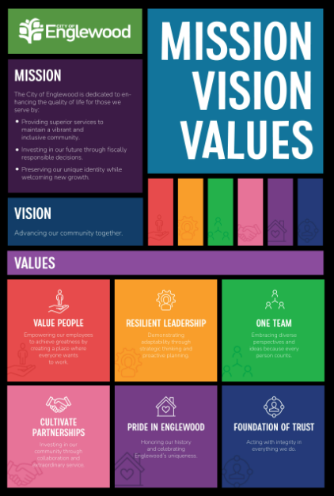
Mission, Vision Values
T

Slide 20
Creating MVVs that Employees Embrace
Champion Team Members
Tim Dodd, CMO
Jamie Safulko, South Platte Renew
Sara Stant, Parks & Rec
Jerry Brown, Community Development
Joel Jose, Police
Chad Read, Police
Kimberly Ramuno, Utilities
Tre Blake, Public Works
Process
Eight focus groups
Over 100 participants
Over 470 unique comments
15 Champion Team meetings
Approved by Council
T

Slide 21
Maintaining & Continuously Improving

Slide 22
Supervisor Training Cohorts 2X Per Year
Session 1: People Leadership and Culture Expectations
Session 2: Introduction to Labor and Employment Law
Session 3: Leave Management and Performance Management
Session 4: Preventing Harassment and Discrimination
Session 5: Navigating Conflict in the Workplace
Session 6: Strategic Planning | Vision, Mission, and Values

Slide 23
Communications & Staff Meetings
Junction newsletter
2022—Known Matter Included recaps
2023—Values recaps
2024—Living the Values employee spotlights
Questions of the Month
Celebration and appreciation
Time for Recognition
Employee recognition events
Council recognitions
Annual awards program
Culture Corners
All-staff
Supervisors All-Hands
Ask Anything (anonymously)

Slide 24
Annual Employee Satisfaction Survey
Began in 2020 to continue open discussions started as part of focus groups
Modified in 2021 to match Choose People curriculum
Online and anonymous
Conducted late fall
T

Slide 25
Participation
YEAR | PARTICIPATION
2020 | 155
2021 | 287
2022 | 222
2023 | 217
T

Slide 26
How satisfied are you with your overall experience as a City of Englewood employee?
T

Slide 27
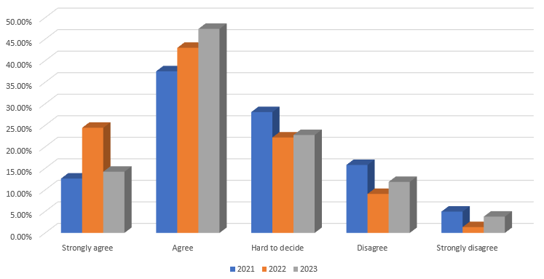
The City values its employees:
T

Slide 28
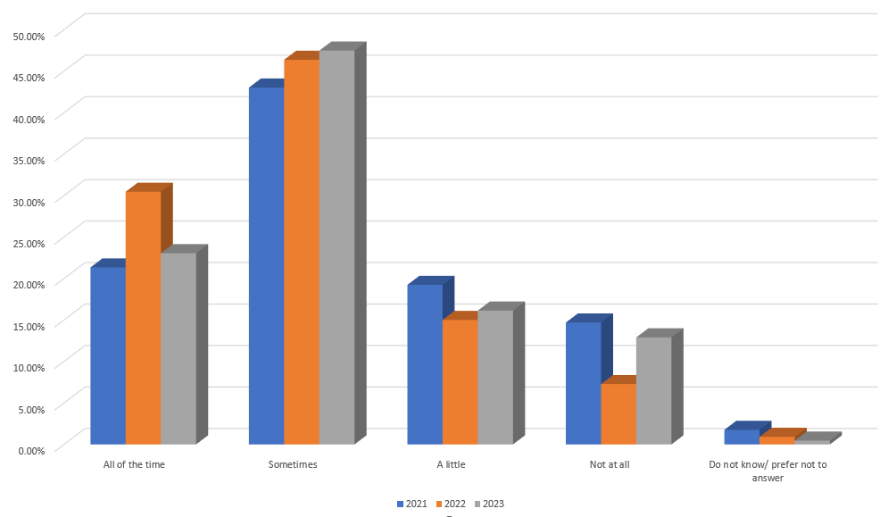
I feel valued (known, mattered, and included) as an individual and contributor to the organization:
T

Slide 29
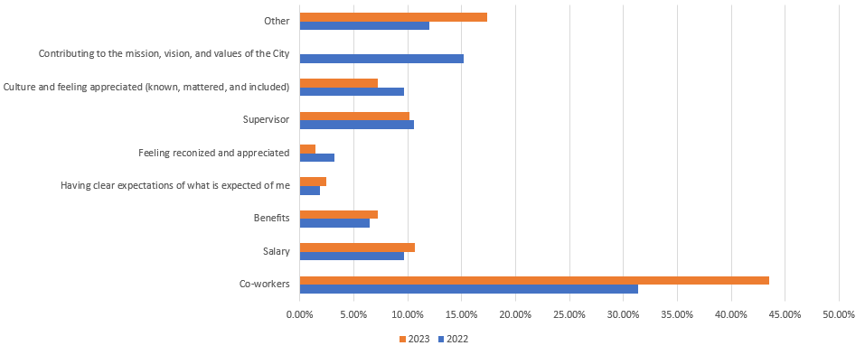
The thing I like most about my job is:
T

Slide 30
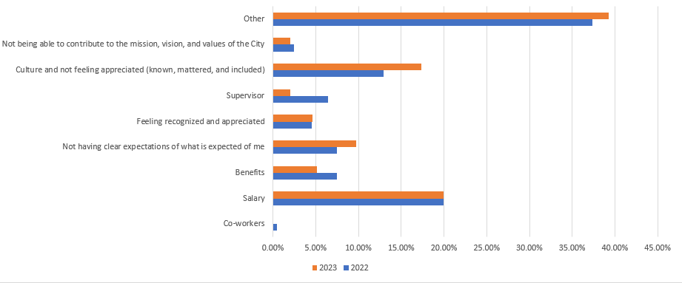
The thing I like least about my job is:
T

Slide 31
Engaging Supervisors to Address Shortcomings
2023 Supervisors Retreat Brainstorming:
Promote inclusivity in the workplace
Improve and maintain positive workplace culture
Promote a healthy work-life balance
Ensure employees are aware of City-wide goals and initiatives, and their role in achieving them
Ensure all employees feel known, mattered, and included
T

Slide 32
What organizational culture efforts have or haven’t worked in your organization?

