Slide 1
Federal Grants for Sustainability & Resiliency
Kate Sipla Local Government Program Manager, Schneider Electric

Slide 2
Grants & Rebates
Collaborative application approach with team of experts
Over $600M captured for our clients to-date
$63M in grants captured since October of 2022
Kate Sipla
Local & State Government
Program Manager
1000+
$3.7B
$2.4B
99.7%
Total Performance Contacts Implemented Nationwide
Total Value of Construction Projects Implemented
Guaranteed Savings
of our Guaranteed Dollars Exceeded Guaranteed Savings

Slide 3
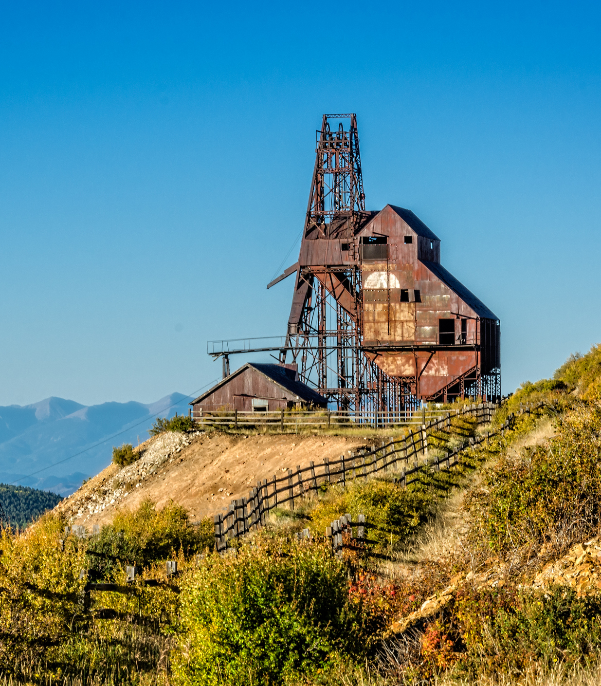
Why Sustainability?
Rising Utility Rates
Deferred Maintenance
Unfunded Capital Improvements
Forced Infrastructure Upgrades (W/WWTP)
Water Conservation
Air Quality
Public Health & Safety
Disaster Preparedness
Power Grid Resiliency
Fossil Fuels & EV Conversion
Economic Development Opportunities

Slide 4
Why now?
It’s more expensive later
Disaster Preparedness
Prevention is cheaper than cleanup
Insurance premiums will increase
Aging Infrastructure
Deferred maintenance costs 15-35% more over time
IIJA and IRA won’t be around forever
Predictable Utility Spending
Lock in rates
Generate and store your own power

Slide 5
Big Picture: Funding for Energy Efficiency & Environment
IIJA: $200B
$73B for Power & Grid
$47B Resiliency
$15B Electric Vehicles & Buses
$48B Water Infrastructure
$21B Environmental Remediation
IRA: $360B
$177B Clean Energy
$35B Climate Action
$35B Air Pollution
$39B Clean Fuel/Vehicles
$37B Clean Energy Incentives
$35B Conservation & Forestry

Slide 6
Federal Grants: DOT
Program purpose: This program supports planning, infrastructure, behavioral, and operational initiatives to prevent death and serious injury on roads and streets involving all roadway users.
Eligible use of funds: Under the planning grant, recipients must use funds to develop a comprehensive safety action plan that is aimed at preventing roadway fatalities and serious injuries, and funding may also be directed to updating an existing plan. Under the implementation grant, recipients may use funds for projects and strategies identified in their action plan that address roadway safety problems. Successful grant applications will adopt technologies and strategies that promote safety, employ low-cost and high-impact strategies, ensure equitable investment, be evidenced based, and align with the Department of Transportation’s mission and priorities.
Eligible Applicants: A metropolitan planning organization; a political subdivision of a State (cities, counties, special districts, or similar unit of local government), a transit district, authority, or public benefit corporation if created under State law; a federally recognized Tribal government; a multi-jurisdictional group composed of entities 1-3
Safe Streets & Roads for All
Estimated FY24 Funding: $1B
Max award: Planning grants $10M Implementation grants $25M 20% cost share
Opened 2/1/24
Closing 7/10/24
Award 12/31/24
LED streetlights, smart traffic lights, traffic cameras
Program website

Slide 7
Federal Grants: EPA
Program purpose: EPA will be distributing $1 billion in funding for clean heavy-duty vehicles between now and 2031. $400 Million will be going to communities in nonattainment areas. The program will accelerate environmental justice efforts in communities overburdened by pollution, help tackle our biggest climate challenges, and create high-quality clean energy jobs.
Eligible use of funds: The incremental cost of replacing a non-zero-emission Class 6/7 heavy-duty vehicle with a Class 6/7 zero-emission vehicle. The purchase and installation of fueling infrastructure that will support vehicles replaced under this program. Driver/mechanic training related to the maintenance and operation of new vehicles and supporting fueling infrastructure, and vehicle warranties. Costs directly related to implementation, management, and oversight of the project, including recipient and subrecipient personnel and benefits, contractual services, consulting on vehicle deployments, travel, supplies, and indirect costs.
Clean Heavy Duty Vehicle Program
Estimated Funding thru 2031: $1B
Max award & cost share: TBA
Opening soon; May/June TBA
Closing 2 months after opening
Award 3 months after closing
EV infrastructure, fleet electrification
Program website

Slide 8
Federal Grants: EPA
Program purpose: This new program will support environmental and climate justice activities that benefit disadvantaged communities through projects that reduce pollution, increase community climate resilience, and build community capacity to address environmental and climate justice challenges. These place-based investments will be focused on community-driven initiatives to be responsive to community and stakeholder input. They are designed to be transformative for communities most adversely and disproportionately impacted by climate change, legacy pollution, and historical disinvestments.
Eligible use of funds: Energy efficiency, fleet electrification, microgrid and battery storage, renewable energy
Eligible Applicants: A partnership between two community-based non-profit organizations (CBOs). A partnership between a CBO and one of the following: a Federally-Recognized Tribe; a local government; an institution of higher education.
Community Change Grants
Estimated FY24 Funding: $2B No cost share
Track I, Community-Driven Investments for Change, is expected to award approximately $2B for 150 projects for $10M - $20M each.
Track II, Meaningful Engagement for Equitable Governance, is expected to award approximately $40M for 20 projects for $1M - $3M each.
Open through 11/24/24; rolling
Program website
Notes:
Track 1 is implementation and Track 2 is planning

Slide 9
Federal Grants: DOE
Program purpose: The ERA Program aims to fund clean energy projects with at least one of the following resilient clean energy objectives:
Improving overall cost-effectiveness of energy generation, transmission, or distribution systems;
Siting or upgrading transmission and distribution lines;
Reducing greenhouse gas emissions from energy generation in rural or remote areas;
Providing or modernizing electric generation facilities;
Developing microgrids;
Increasing energy efficiency.
Eligible Applicants: Institutions of higher education, non-profit entities, for-profit entities, Tribal Nations, state and local governmental entities, consortia. Population must be under 10,000 based on most recent census.
Energy Improvement in Rural & Remote Areas (Small Projects)
Estimated FY24 Funding: $50M
Award range: $500K-$5M
Cost share: minimum 50%
Open estimated 5/11/24
Concept paper due 7/13/24
Closing 10/26/24
Award 2/15/25 (10-100 projects)
Program website

Slide 10
Federal Grants: USDA
Program purpose: This program provides affordable funding to purchase, construct, and/or improve essential community facilities in rural areas.
Eligible Applicants: Public agencies, community-based non profit corporations, and Federally recognized tribes with no more than 20,000 residents according to the latest US Census data.
Eligible Facilities:
Health care facilities such as hospitals, medical & dental clinics, nursing homes or assisted living facilities
Public facilities such as town halls, courthouses, airport hangars or street improvements
Community support services such as child care centers, community centers, fairgrounds or transitional housing
Public safety services such as fire and police stations, prisons, police and fire vehicles, public works vehicles or equipment
Educational services such as museums, libraries or schools
Utility services such as telemedicine or distance learning equipment
Local food systems such as community gardens, food pantries, community kitchens, food banks, food hubs or greenhouses
Community Facilities Direct Loans
Low interest direct loans & grants
Open year round
Priority given to communities of <5500 residents or median household income below 80% of state nonmetropolitan median
Varying levels of cost share for grants
Program website

Slide 11
Federal Grants: USDA
Program purpose: The Rural Energy Savings Program (RESP) provides loans to rural utilities and other companies who provide energy efficiency loans to qualified consumers to implement cost-effective energy efficiency measures. RESP will help lower energy bills for rural families and businesses and will reduce barriers to investing in energy efficiency projects.
Eligible Applicants: RUS makes loans to corporations, states, territories, and subdivisions and agencies thereof; municipalities; people's utility districts; and cooperative, nonprofit, limited-dividend, or mutual associations that provide or propose to provide: The retail electric service needs of rural areas; The power supply needs of distribution borrowers under the terms of power supply arrangements satisfactory to RUS; Or eligible purposes under RESP, including energy efficiency, renewable energy, energy storage or energy conservation measures and related services, improvements, financing, or relending.
Rural Energy Savings Program
Loan up to 20 years at 0% interest
Up to 5% interest rate for relending to qualified consumers up to 10 years
Up to 4% of loan total for startup costs
Program website

Slide 12
Resources for Grant Support
COG
DOLA
Colorado Energy Office
Past awards as examples
Regional grant efforts – reach out to your neighbors
Schneider Electric team
Notes:
KATE
Before we can talk about driving economic development for our communities, our public agencies need to have sound financials. We can’t invest in others until we invest in ourselves.
who has seen their utility bills go DOWN over the last 5 years? CDPHE forcing Wastewater Treatment Plant upgrades
How many of you have seen your electric and gas rates go DOWN in the last 5 years?
Anyone facing having to build a brand new WWTP due to CDPHE regulations?
Sustainable infrastructure and practices can actually bring in opportunities for new revenue streams, which can help you address these things and more. We’ll go into more detail on this later.
I also think a good reason to ask ourselves why we should invest in sustainability is our ever increasing lack of natural resources. I think it’s safe to say we’re all worried about the availability of clean water for our communities over the next 20-50 years, yes? And lack of water has affected a lot of us due to wildfires and then subsequent flooding like we talked about earlier? We’re seeing strain on power grids in other states like Texas and California. Can you imagine wanting to move to or start a business in a place that doesn’t have reliable power? We also know that gas powered vehicles are being phased out whether we like it or not, so we may as well start thinking about that transition proactively.

Slide 13
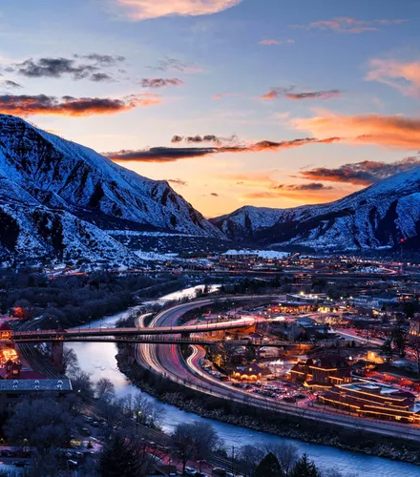
Takeaways
Investing in sustainability creates healthier, more attractive, more resilient communities
Consider long term impact, not just up front costs
Leverage sustainability to your economic advantage
There has never been more funding available for sustainability!

Slide 14
Q&A
Kate Sipla: kate.sipla@se.com
Eric Lowe: eric.lowe@state.co.us

