Slide 1

Leading Democratically: Fostering Management Innovation, Advancing Public Trust and Building Resilient Communities
Valerie Lemmie, Senior Advisor, State and Local Government | 04.18.2024

Slide 2
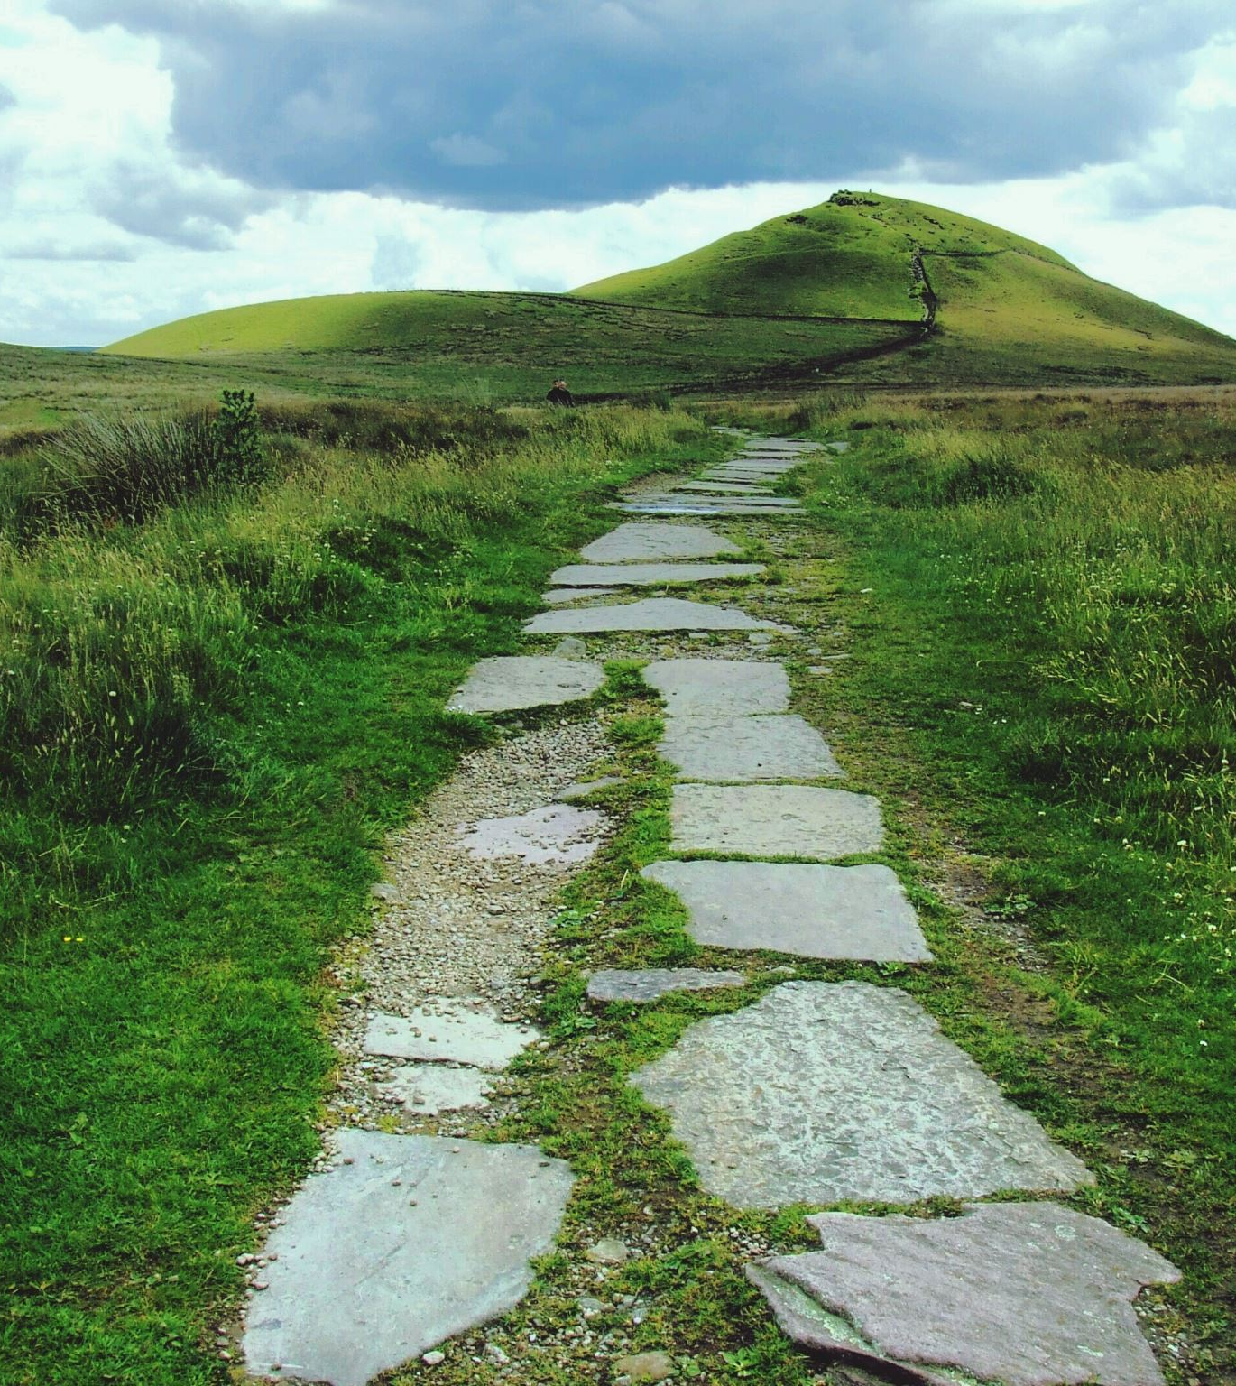
LAND ACKNOWLEDGEMENT
We gather today on the ancestral lands of indigenous peoples who have stewarded this place for centuries. We extend our deepest respect and acknowledge our profound obligation to these original caretakers and to their descendants
We recognize this acknowledgment is merely a step in our journey to understand our place within a history marked by dispossession and marginalization.
We are committed to grappling with the enduring legacy of colonialism, an ongoing process that not only reshapes lands but also structures of power and governance.
This acknowledgment is not an endpoint, but rather a commitment to integrate a deeper understanding of the ongoing impacts of colonialism into our work. In doing so, we aim to be more thoughtful and engaged in our work to advance inclusive democracies.

Slide 3
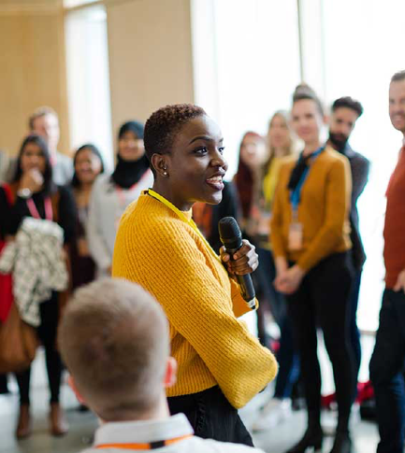
DISCUSSION TOPICS
Lemmie Background and Experience
What Does the Kettering Foundation Do?
Fostering Democratic Innovation
Cultivating Public Trust
Building Resilient Communities

Slide 4
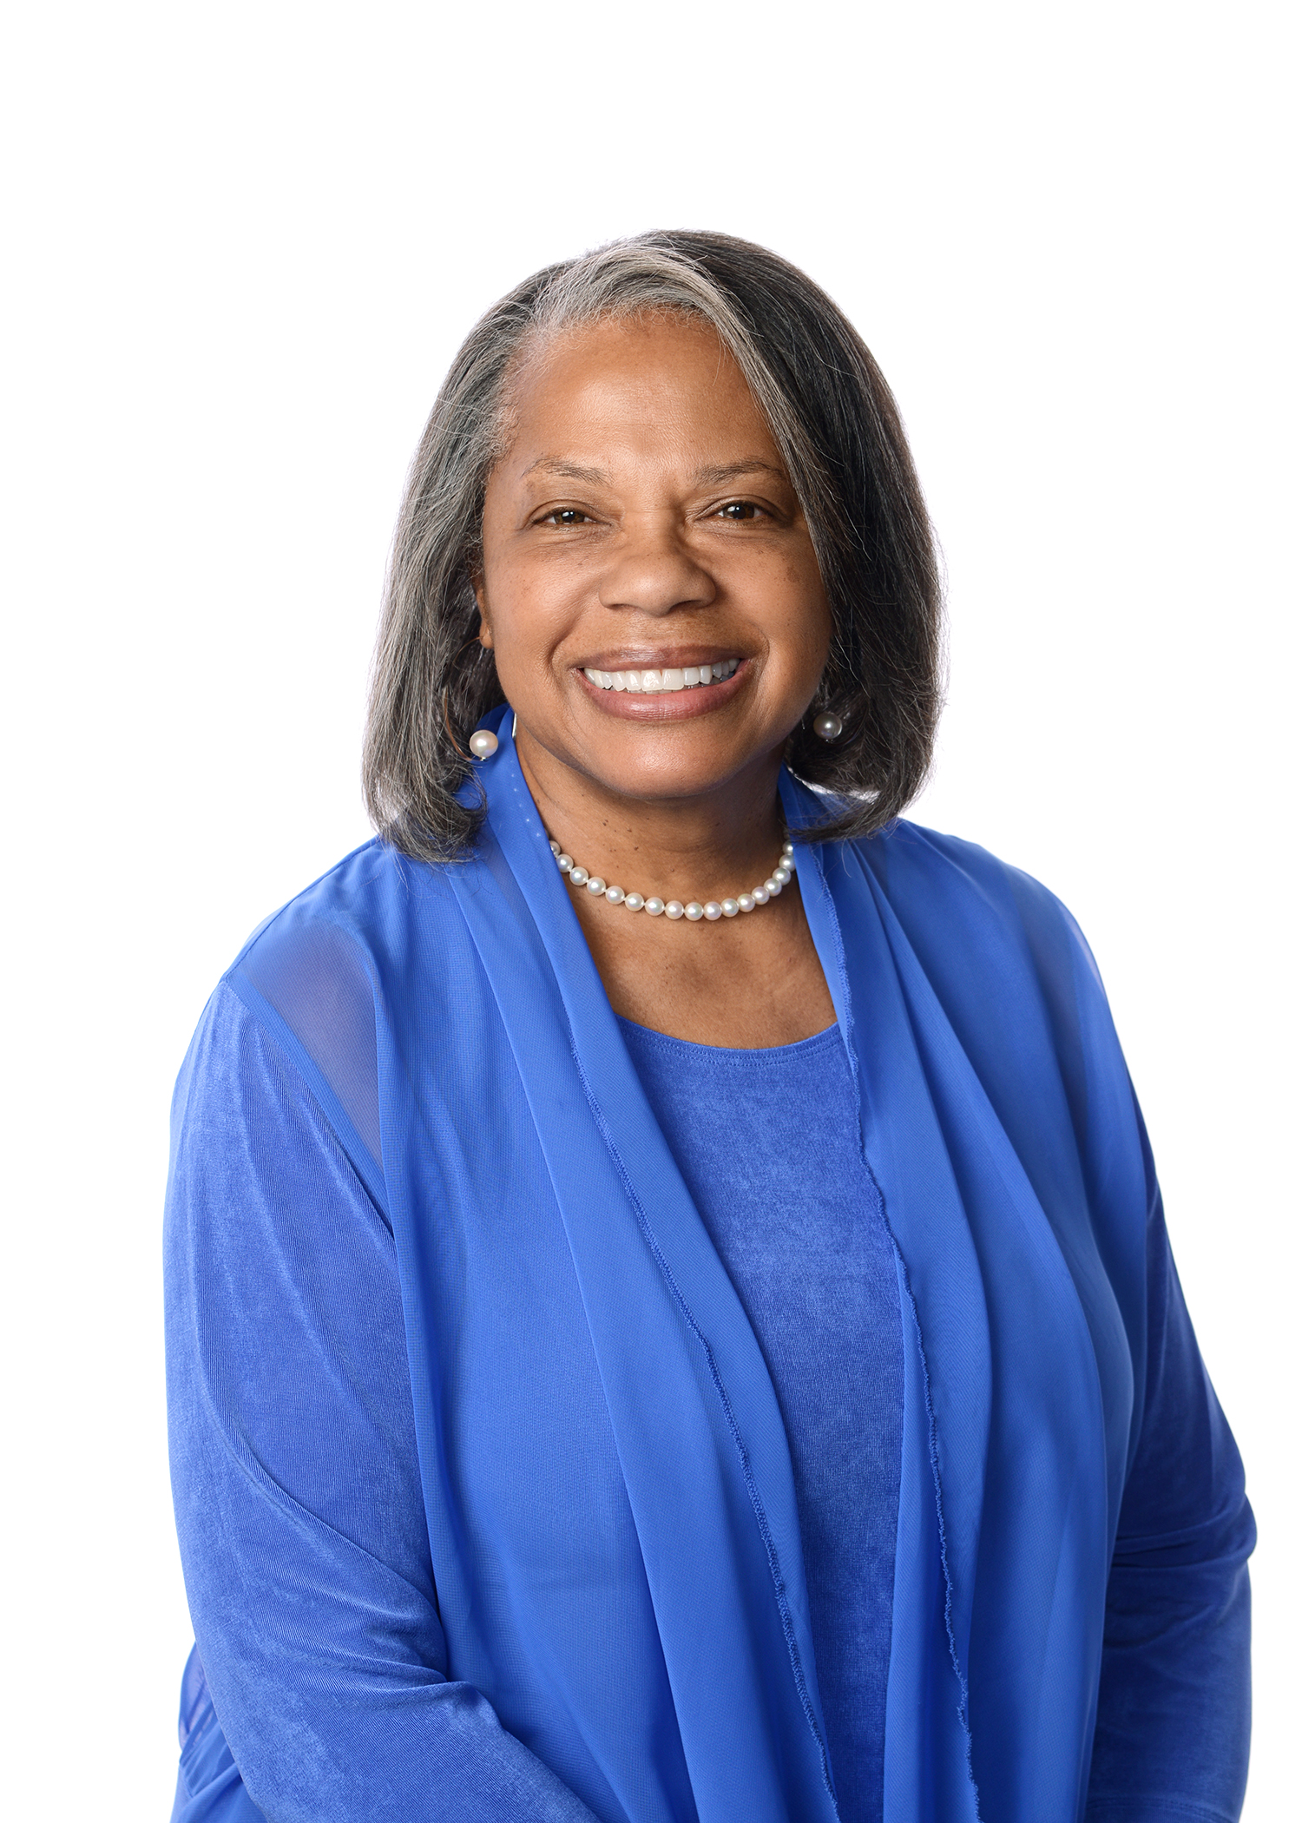
BACKGROUND and EXPERIENCE
COMING OF AGE DURING PROTEST MOVEMENTS of the 1970s
WORKED FOR KEY LEADERS IN THE MODERN CIVIL RIGHTS MOVEMENT
CITY MANAGER
PUBLIC UTILITY COMMISSIONER
CONGRESSIONAL DISTRICT DIRECTOR
ADJUNCT FACULTY and RESEARCHER
CIVIC LEADER
4

Slide 5

WHAT DOES THE KETTERING FOUNDATION DO?

Slide 6
DEFEND INCLUSIVE
DEMOCRACY
Vision
We envision a world of thriving democracies where the rights of all are protected, and people fulfill their civic responsibilities.
Mission
We advance inclusive democracies by fostering citizen engagement, promoting government accountability, and countering authoritarianism.
Principles of Management
We encourage democratic practices and shared work between public officials and citizens.

Slide 7
OUR GUIDING BELIEFS and VALUES
Democratic Integrity: We believe in the rule of law and that all people have the right to free and fair elections, accountable leadership, and the peaceful transfer of power.
Civic Responsibility: We believe that people have a responsibility to participate in their communities and to make demands of their governments for the common good.
Justice: We believe that all people have a right to fair and equitable treatment by institutions and systems of governance.
Belonging: We believe that democracy must embrace the full diversity of life experiences, beliefs, and voices of all.
Trustworthiness: We believe that democracy requires civic and governmental institutions that are honest, transparent, and accountable.

Slide 8

FOSTERING MANAGEMENT INNOVATION

Slide 9
“History is not merely something to be read and it does not merely refer to the past. The great force of history comes from the fact we carry it with us, are unconsciously controlled by it and history is present in all we do. It could scarcely be otherwise, since it is to history that we owe our frames of reference, our identities, and our aspirations.“
James Baldwin

Slide 10
POLLING QUESTION
WHAT DOES DEMOCRACY MEAN TO YOU?
One Word Response

Slide 11
EVOLVING ROLE OF MANAGERS
Foster Democratic Innovation
  Address inequality and justice
  Defend threats to democracy
Cultivate Public Trust
  Shared work
  With the people strategy
  Community as educating resource
Create Resilient Communities
  Explore new revenue sources for fiscal sustainability
Broker Intergovernmental Relationships
  Expert on regional issues
Build Healthy, Sustainable Communities
  Support community well-being
Recognize 5 Pillars of Public Administration
  Equity
  Efficiency
  Engagement
  Effectiveness
  Economy
Lead Inside and Outside the Bureaucracy
  Work with elected officials and civic leaders
Advance Civic Renaissance
  Create spaces for civic renewal and learning

Slide 12
LEAD DEMOCRATICALLY
Relational Intelligence
  Strengthen collaboration with electeds
  Build relationships inside and outside bureaucracy regionally and statewide
  Nurture relationships with aligned interests
Citizen-Centered
  Engage with the public as collaborators and allies
  Facilitate trust-based community partnerships
  Create spaces for civic learning

Slide 13
ADDRESS INEQUALITY
Acknowledge Place Based Historic Harms
  Redlining (Dayton PBS Broadcast)
  Urban Renewal (Community Relocations)
  Protest Movements (1960s Riots)
  Catastrophic Event (Burning of Black Wall Street)
Advance Inclusive Democracy
  Foster Citizen Engagement
  Promote Government Accountability
  Counter Authoritarianism

Slide 14
ADDRESS INEQUALITY
Advance Belonging Community
  Address Income Inequities (Living Wage)
  Strengthen Community Support for Public Education (Learn to Earn Dayton & Cincinnati’s Strive Partnership)
Create Incentives for Affordable Housing
  Bonus Densities/Tax Credits
  Stringent Code Enforcement (Environmental Court)
Leverage Healthcare Resources
  Mental Health Response and Family Intervention Teams
  Declare Racism Mental Health Problem
  Fund Racial Reconciliation & Education Programs (Montgomery County, Ohio)

Slide 15
DEFEND THREATS TO DEMOCRACY
Authoritarianism
  Ensure Voter Participation, Free Speech, Electoral Independence
  Promote Cross-Racial Solidarity as Essential Part of Democratic Advancement and Power for Marginalized Groups. Angela Glover Blackwell
Anti-Democratic Initiatives
  Support Multiracial Democracy
  Advance Policy Innovation, Economic Transformation, and Cultural Change
  Commit to Racial/Economic Equity, with Clear Goals, Measurable Benchmarks, and Transparent Results
Loss of Civic Citizenship
  Teach Citizenship and Civic Responsibility in Recreation and Culture Departments

Slide 16
CULTIVATING PUBLIC TRUST

Slide 17
“My interest is in the future because I am going to spend the rest of my life there.”
Charles F. Kettering

Slide 18
POLLING QUESTION
WHAT DO YOU NEED TO FEEL COMFORTABLE ADVANCING DEMOCRATIC PRACTICES THROUGH DELIBERATIVE COMMUNITY CONVERSATIONS?
ONE WORD RESPONSE

Slide 19
Build Trust Through Shared Work
Align Professional Routines with Way Citizens Work to Produce Shared Public Goods
Name Problems to Capture Public Value
Frame Issues to Address Tensions and Trade-Offs/Find Common Ground/Options
Deliberate Options/Collaborative Decision-Making
Identify Resources/Community Assets
Act Together To Address Problems
Create Culture of Learning

Slide 20
PROMOTE DEMOCRATIC PRACTICES
Foster Public Commitment to Democratic Principles, Practices and Values
Create Policies that Enhance Civic Health and Civic Muscle
Develop Communications Strategy that Incorporates Opportunities for Community Collaboration, Shared Problem-Solving and Stories about the Work
Provide Accurate Information on Key Public Issues

Slide 21
BROKER INTERGOVERNMENTAL RELATIONSHIPS
Informed on Issues in Your Region
Collaborate with Aligned Interests
  Professional organizations
  Academic institutions
  Philanthropy/business
Take Positions on Non-Partisan Issues that Promote Good Government
  Pre-emption
  Citizenship rights
Lobby for community initiatives not just local government needs
Regional Fed/State Delegation Visits (PEDAC)
Informed on Issues in Your Region
Collaborate with Aligned Interests
  Professional Organizations
  Academic Institutions
  Philanthropy/Business
Take Positions on Non-Partisan Issues that Promote Good Government
  Pre-Emption
  Citizenship Rights
Lobby for Community Initiatives and Local Government Needs
Regional Fed/State Delegation Visits (PEDAC)

Slide 22
SAFETY AS COMMUNITY RESPONSIBILITY
Citizenship Responsibility, Not Just Police
Align Work of Citizens and Police with Focus on Benefits of Coproduction
  Foster police-community partnerships that build relationships, enhance empathy, and humanize interactions
  Foster constructive, candid, and trustworthy communications
Coordinate Public Safety and Public Health Responses
Public Trust/Conferred Legitimacy Pillars of 21st Century Policing*
-------------
*President’s Task Force on 21st Century Policing. Final Report

Slide 23
BUILDING RESILIENT COMMUNITIES

Slide 24
"When I dare to be powerful, to use my strength in the service of my vision, then it becomes less and less important whether I am afraid.“
AUDRE LORD

Slide 25
POLLING QUESTION
WHAT IS YOUR VISION FOR YOUR COMMUNITY?
ONE WORD RESPONSE

Slide 26
FISCAL SUSTAINABILITY
Engage Public for Shared Ownership
  Participatory Budgeting
Develop New Funding Strategies
  Income tax limitations post COVID
Explore Regional Tax-Sharing and Public Investment Opportunities
  Joint economic development districts
  Reinvesting TIFs in marginalized neighborhoods

Slide 27
PROMOTE COMMUNITY WELL-BEING
Empower Self-Identifying Communities
Support Communities in Preparation of Local Well-Being Plans
Inject Civic Entrepreneurship and Community Investment Strategies
  Civic Responders
  Baby Bonds (publicly funded investment accounts for children)
  Community Co-Ops and Collaboratives (food, redevelopment income stream)
Encourage Community Voice and Complementary Production of Public Work
  Design, Targeting, and Delivery of Public Services Through PB
  Deliberation and Dialogue
  Acting Collectively to Address Shared Community Problems
Foster Relationships Among Communities, Philanthropy and Business
  Trust-Based Philanthropy

Slide 28
DEMOCRATIC CIVIC ENGAGEMENT
Determine Best Civic Engagement Strategy for Issue
  Deliberative forum
  Citizen assembly or jury
  Public hearing
  Information transfer
Incorporate Public Concerns, Needs, Interests, and Values into Policy Decisions
  Wicked problems
  Democratic practices
Importance of Communications and Social Media Strategies
  Tell your story
Collaborations and Collective Impact
  Clear goals and metrics
  Work with trusted community partner

Slide 29
POLLING QUESTION
WHAT CAN YOU DO TO CREATE AN INCLUSIVE COMMUNITY?
ONE WORD RESPONSE

Slide 30
These days, everyone seems to be drawing lines and picking sides. Now more than ever, we need leaders who can keep their heads when everyone else is losing theirs. The Midwesterner in me calls this grit. But grit isn't formed by standing on your side and holding the line. Grit is formed by going through the middle - by having the hard conversation, by building tough bridges, by seeking consensus. Start by asking questions. When you ask questions, you move from polarization to problem solving."
SUSAN NEELY,
PRESIDENT AND CEO OF THE AMERICAN COUNCIL OF LIFE INSURERS

Slide 31

THANK YOU
vlemmie@kettering.org

