Slide 1
If…… Then
Population, Jobs, and Housing
Trends and Transitions
CCCMA, April 2024
State Demography Office, Department of Local Affairs
Demography.dola.colorado.gov

Slide 2
Everything is Connected
Population
  Age
  Births slowing
  Race & Ethnicity
  Housing
  Community services
  Supply
Labor Force
  Skills
  Age
  Commuting
  Migration
Drives Economy
  Consumer Expenditures
  Age
  Income
Employment
  Industry trends
  Environment
  Skills
  Remote?
  Demand
Notes:
Connect to:
Labor
Housing
Industry
Food
Supply Chain
Infrastructure
BR&E
Talent
Data

Slide 3
Big Picture Trends
Population growing at a slowing rate – births down, deaths up
Migration and mobility slowing
  Harder to attract and retaining the best and brightest
  “In” migration similar levels, growing “out” migration
Demand for labor (new jobs and retirements) drives migration
Aging – impacts everything
  Largest share of future growth is the 65+
  Early working age and youth becoming smaller share of total pop
  Growing race and ethnic diversity.
Notes:
US – 328.2 million, + 1.5 million or .5%
Slowest annual growth rate since 1918
Slower birth rate, increasing deaths, fewer international migrants.
Colorado - - 5,758,736
Ranked 8th fastest 1.2%
7th in total growth 67,449 – slower than great recession
Growth of 725,000 since 2010
Slower births, increasing deaths, fewer net migrants

Slide 4
Big Picture Numbers
 | 2010-2020 |  | 2020-2021 |  | 2021-2022 |  | 2022-23
United States | 22.3MM | 7.4% | 520k | 0.1% | 1.256MM | 0.4% | 1.643 | .5%
Colorado | 744.5k | 14.8% | 26.5k | 0.5% | 27.7k | 0.5% | 36.5 | .6%
Colorado Rank | 9th | 6th | 11th | 20th | 12th | 19th | 9th | 18th
2010 – 2020 - Second slowest decade for US in terms of growth
2020 – 2021 – Slowest ever recorded growth rate -17 states lost population
2021 – 2022 – Some return to pre-COVID19 states lost population
2022 – 2023 - 8 states lost population – 19 states natural decline, immigration increases
Notes:
US – Growth is slowing
2010-2020 second slowest decade - +22.3M, 7.4%
2020-2021 – Slowest annual growth rate .1%, +520K
17 states lost population
2021-2022 - +1.256M, .4%, 19 states lost population
CO – Growth is slowing
2010-2020 + 744,500, 14.8%.
6th ranked percent change, 9th in total growth
2020-2021 + 26,500, .5% growth rate
Ranked 20th in percent growth and 11th in total growth
2021-2022 +27,700, .5% growth rate
Ranked 19th in percent growth and 12th in total

Slide 5
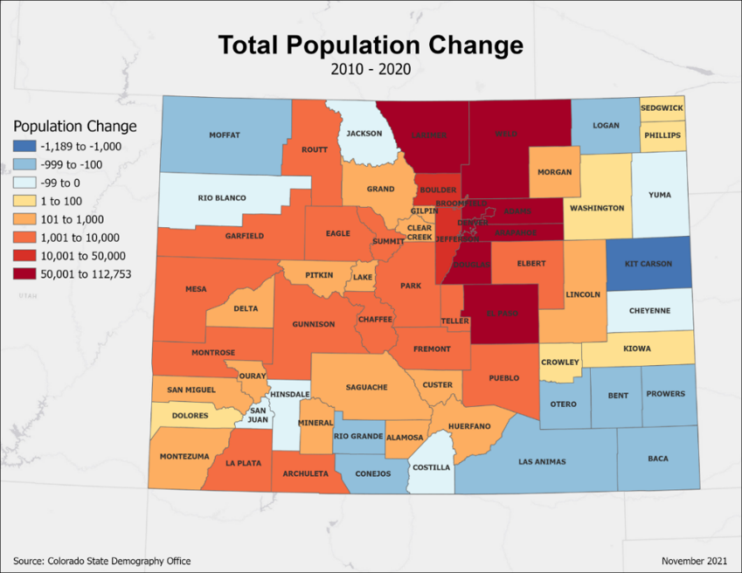
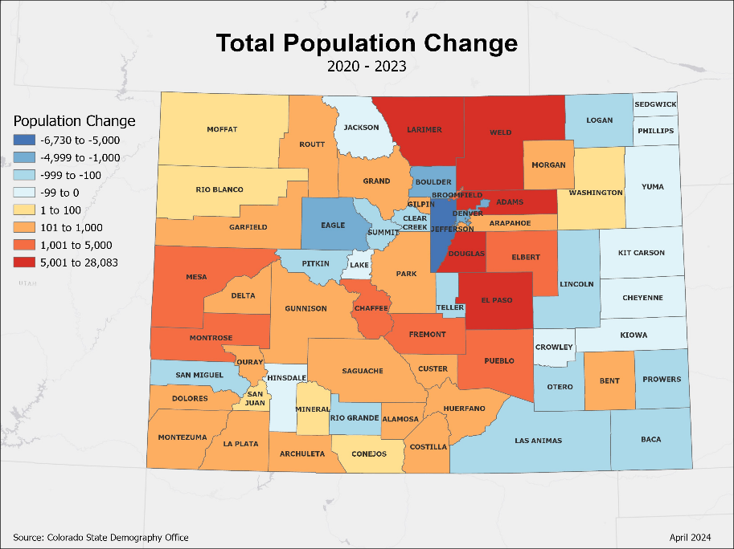
2010 to 2020 - 95% of population and job growth along Front Range
2020 to 2022 – Decreased to 75%, with a number of Denver Metro Counties losing population
2022 to future – Forecast to return more of a pre-COVID trend
Source: Colorado State Demography Office Population Estimates, Accessed March, 2024
https://gis.dola.colorado.gov/ComponentsOfChange/
Notes:
In terms of where growth has been and is going to be in Colorado…

Slide 6
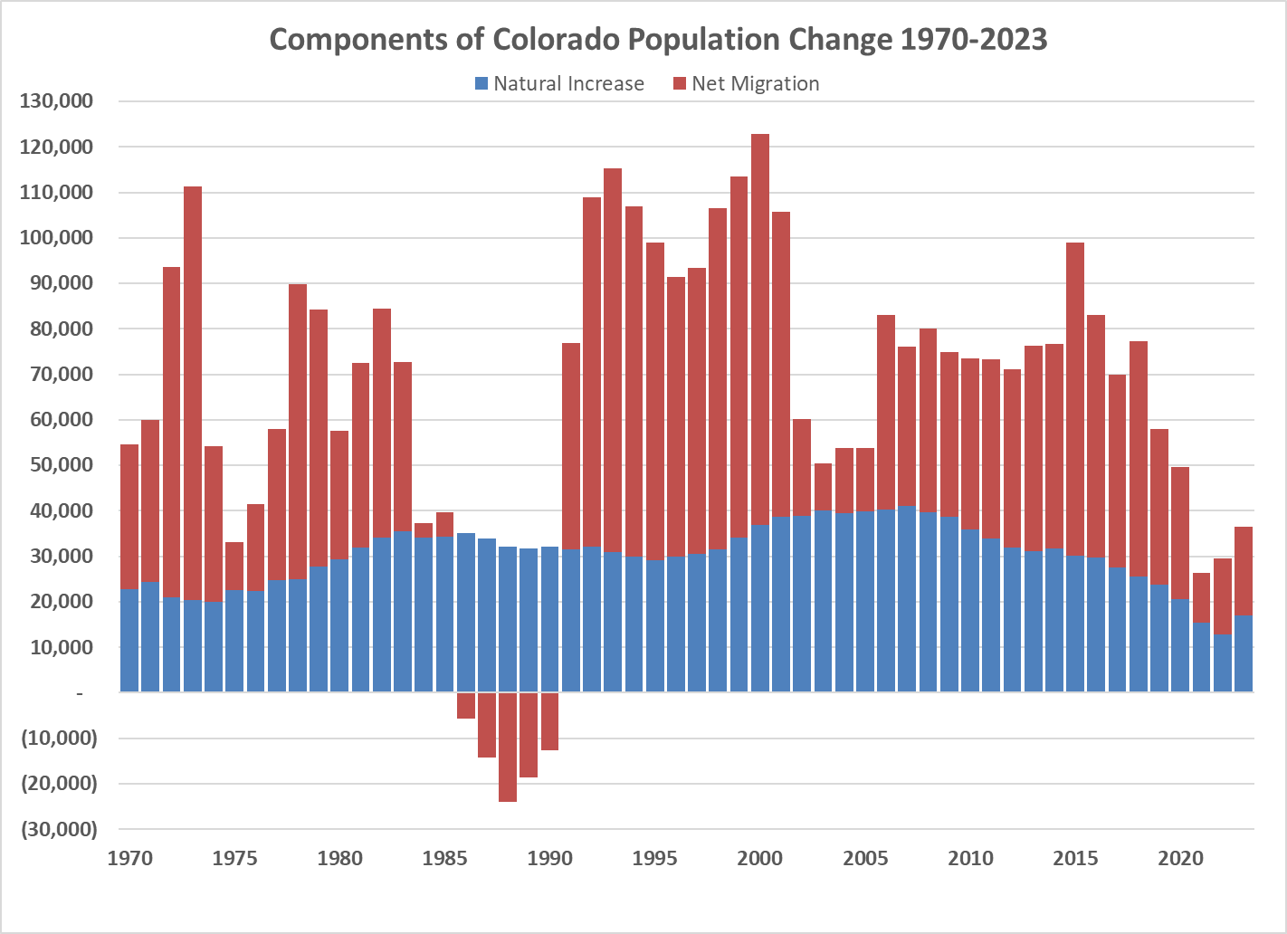
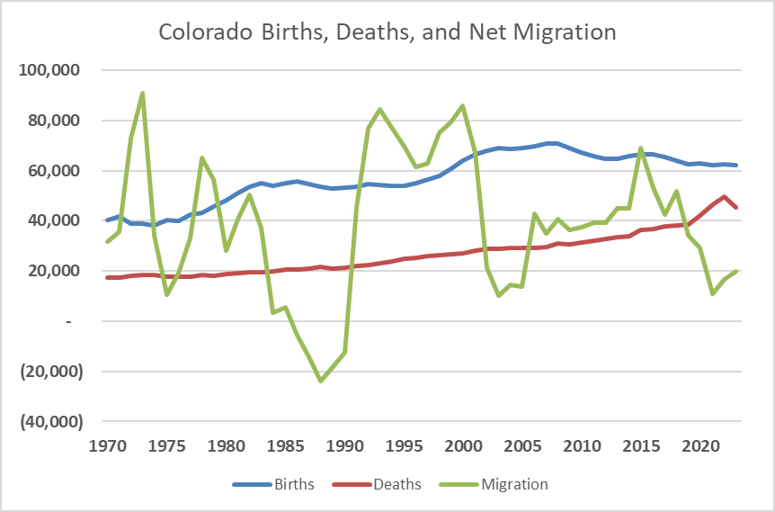
Colorado growth slows from an annual average of 74K last decade to 30,000 average so far this decade
2023
62K – Births
45K – Deaths
20K - Migration
Source: State Demography Office
Notes:
UPDATE to 2019

Slide 7
So What?

Slide 8
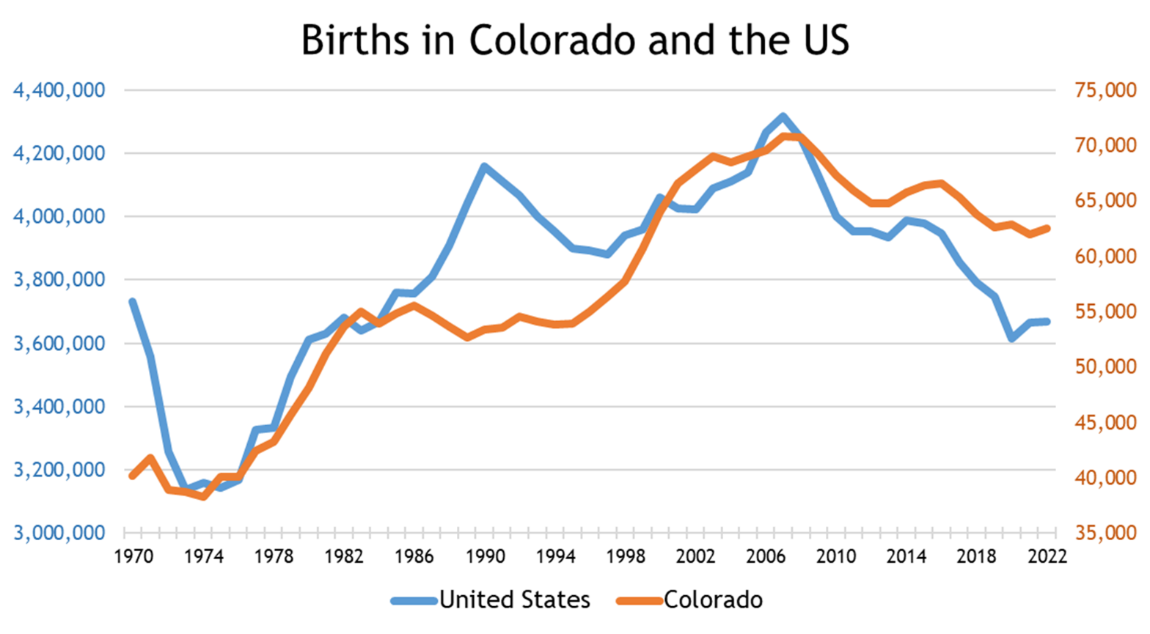

Slide 9
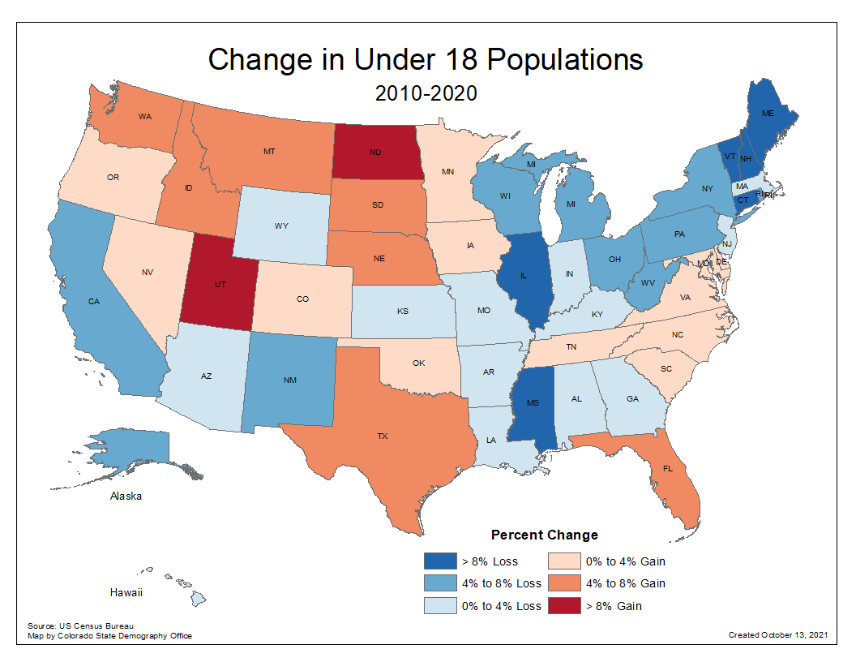
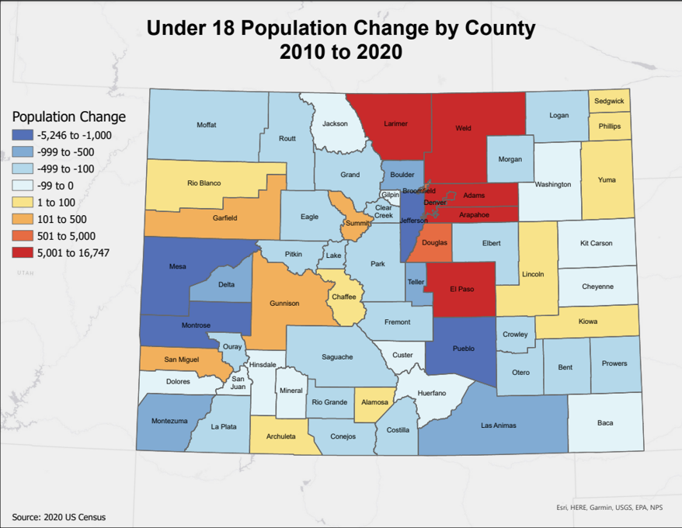
Births down 650,000 in the US compared to peak in 2007.
Population Under 18 Declined by over 1,000,000 over the decade
27 states lost population under 18
Colorado +38,000 over decade, 43 of 64 declined
Census 2010 and 2020

Slide 10
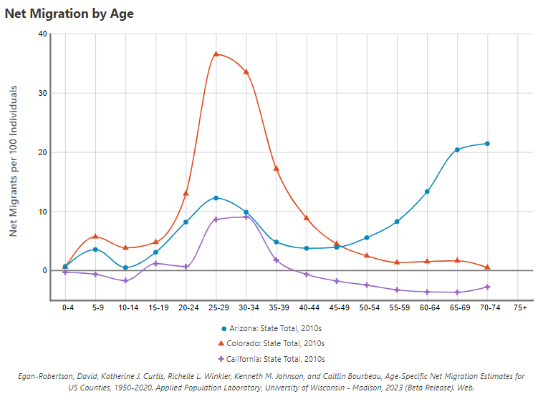
Who does Colorado attract?
With fewer young adults in the future, how could this impact Colorado?
Competition
Labor Force
Higher Ed
Housing
What else?
Colorado
Arizona
California
https://netmigration.wisc.edu/

Slide 11
Net Migration By Age Typologies defined by dominant feature of the age of migrants
Young Adults Ages 20-30
Early career (6 counties)
University influence (5)
Resort influence (8)
Young adult out (18)
Adults Ages 30+
Family (5)
Retirement destination (14)
Prison influence (4)
Combination Counties: Denver, El Paso, Mesa, Weld
Typologies inspired by research from Richelle L. Winkler, University of Wisconsin-Madison
Winkler, R.L., B. Wireman, K. Johnson. 2023. Signature Patterns: Continuity and Change in Age-Specific Net Migration. Presentation to the Population Association of America annual meeting. April 14, 2023. New Orleans, LA.

Slide 12
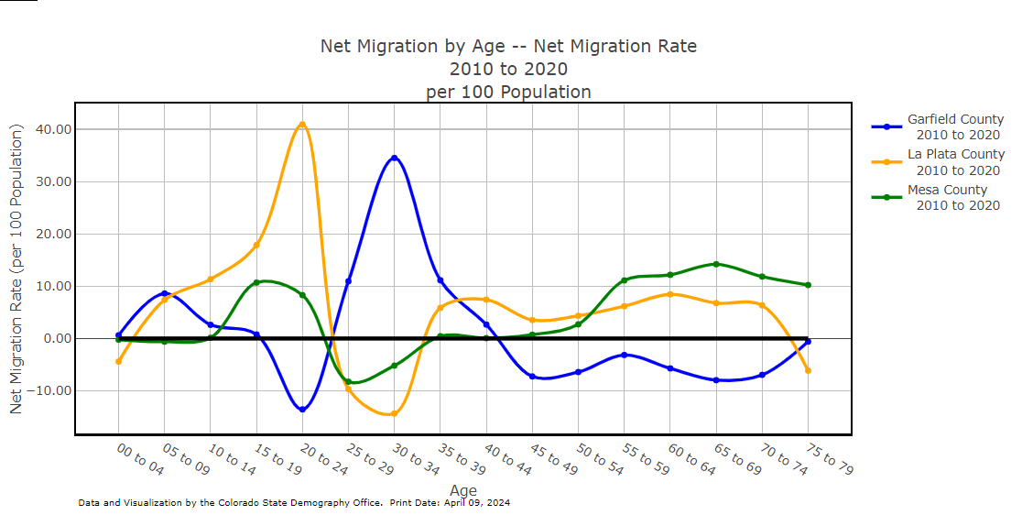
https://demography.dola.colorado.gov/assets/html/netmigcomp.html

Slide 13
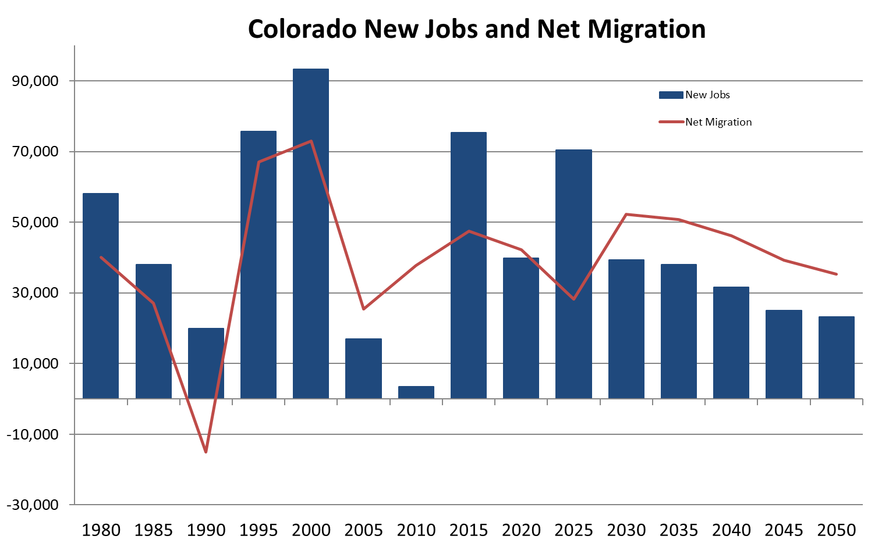
New Jobs + Retirements = Demand for Migration
40K new jobs
40K retirements
?? remote jobs
= 80K+ workers
Retirements
Jobs Are People
https://gis.dola.colorado.gov/Jobs_Migration_Chart/

Slide 14
The Economy

Slide 15
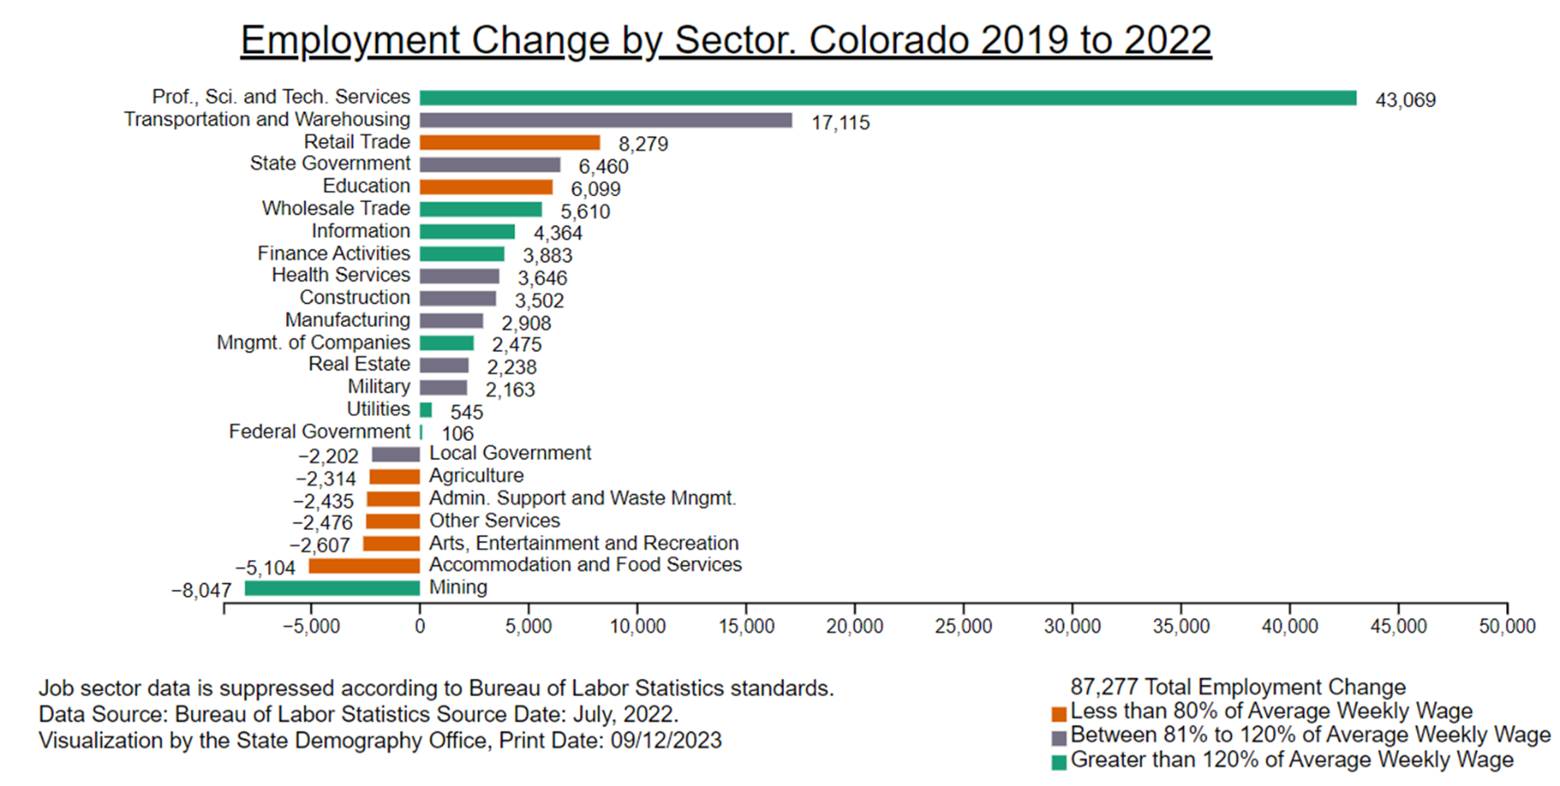
Total jobs recovered from COVID
Unemployment 3.5% - up slightly from last year
68.1% labor force participation rate – 5th highest in US
2:1 - Job openings to unemployed ratio vs. 1.5:1 for US
High wage jobs growing
  Creates demand for lower wage jobs
  Demand for housing
https://gis.dola.colorado.gov/Jobs_by_sector_chart/

Slide 16
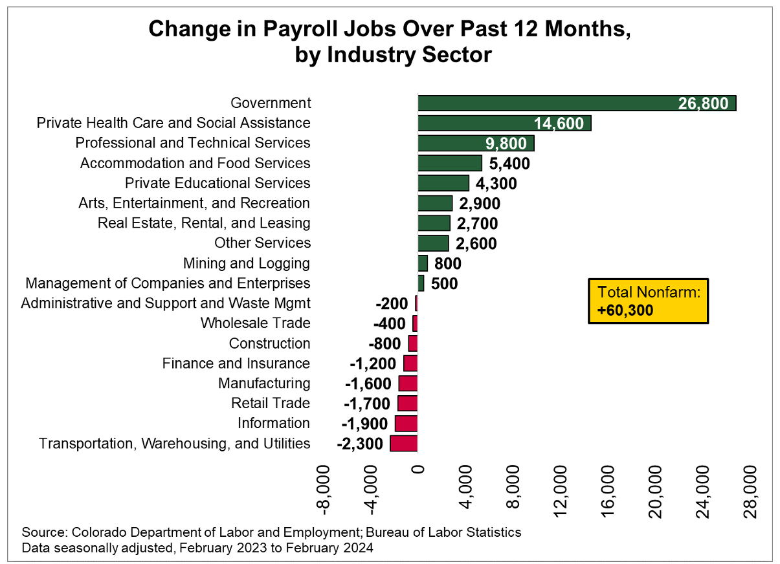
What types of jobs and wage rates are growing in your area?
Jobs drive migration
https://lmico.app.box.com/v/employment-situation-2024-02
Notes:
2019 to 2022
Added 87k jobs (2.5%)
50% Prof, Sci, Tech Services, 20% Transportation and warehousing
Biggest declines in Mining; Accommodation and Food Services; Arts Entertainment and Recreation

Slide 17
Age Matters
Colorado is young but aging
Preferences – where people shop and what they buy.
Housing – type, size, mobility
Labor Force
Income
Service Demands

Slide 18
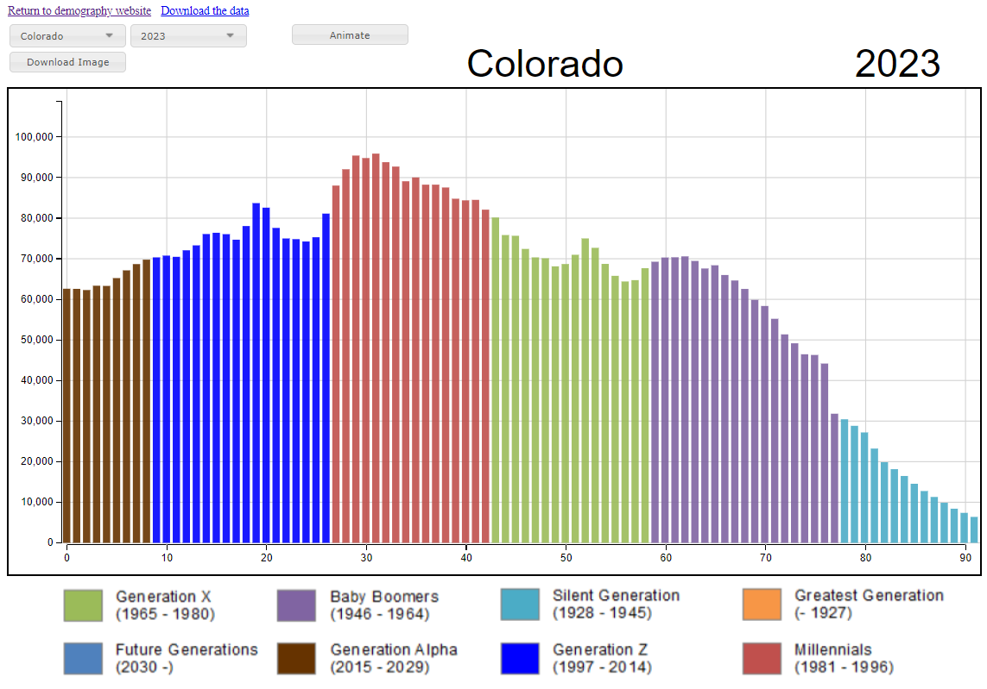
Peak Millennials aging into prime childbearing and home buying
State Demography Office, V2022

Slide 19
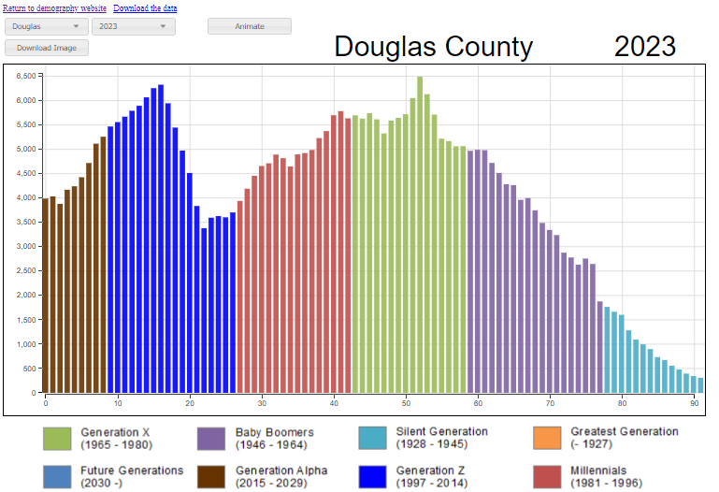
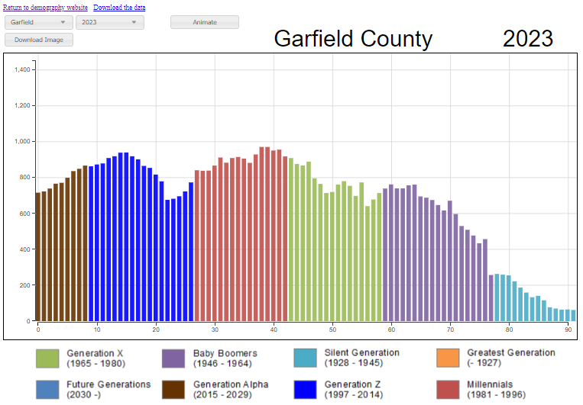
How does Age impact:
Demand for services
Labor force
Jobs
Housing
K12
Sales Tax
https://gis.dola.colorado.gov/Age-Animation-Bars/

Slide 20
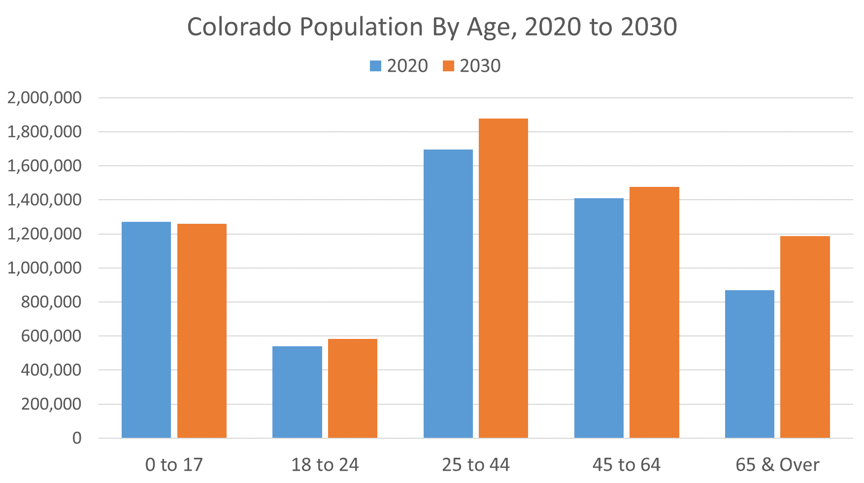
Migration
Most of these folks already live here and most of them own their house.
https://demography.dola.colorado.gov/assets/html/population.html
Notes:
6th Youngest State, 3rd fastest growth in 65+
2015-30 increase 65+ 711,000 to 1,200,000
Economic Driver
Impact on occupational mix. Growing at 5% per year. Wages/Income
Labor Force – growth in retirees
Worker vs. non-worker mix changing
Housing – primarily home owners
Income – Downward Pressure
Health/Disabilities
Transportation
Public Finance – Downward Pressure

Slide 21
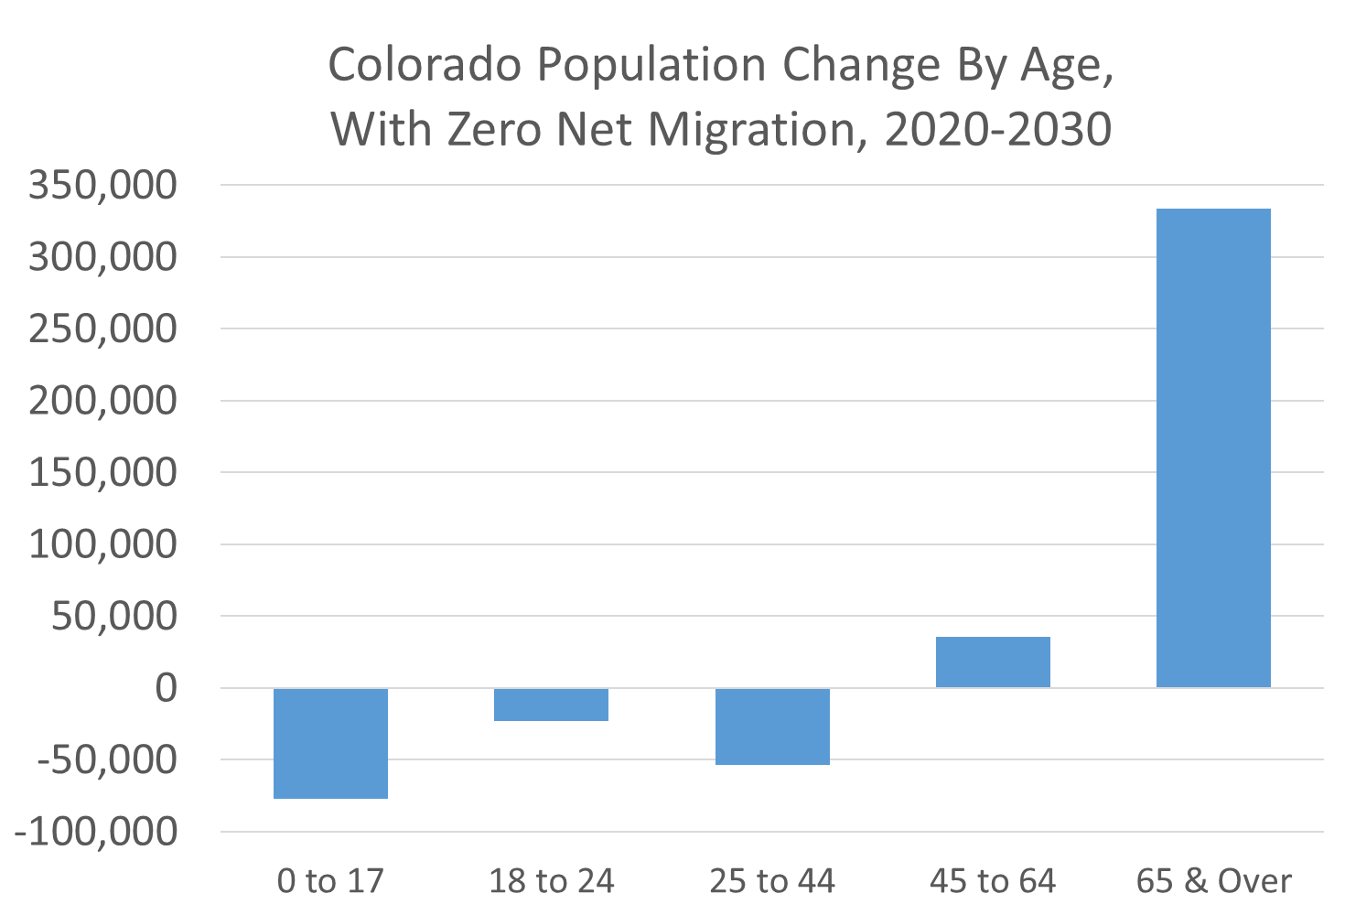


Slide 22
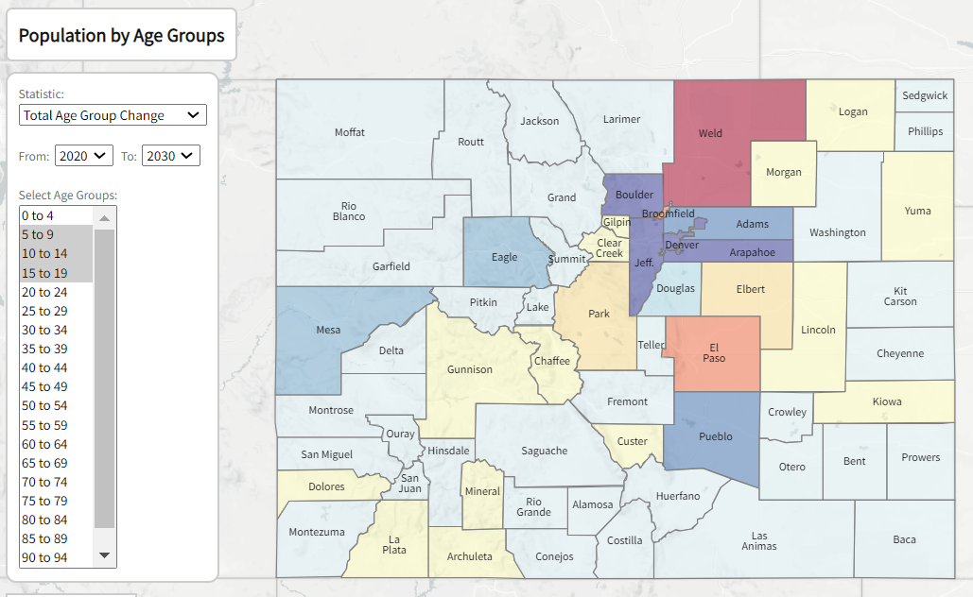
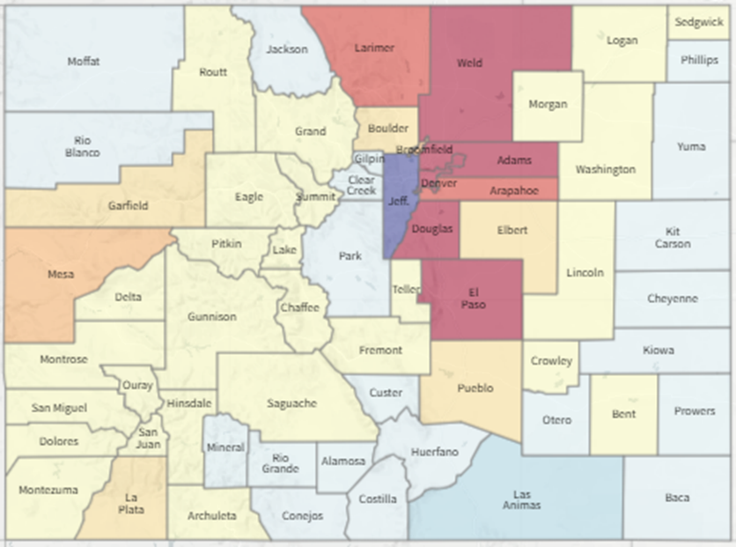
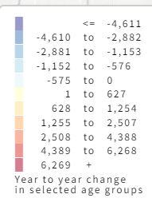
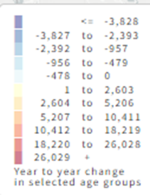
Change in School Age Population 2020-2030
Change in the Working Age Population 25-64, 2020-2030
https://gis.dola.colorado.gov/AgeMap/

Slide 23
Implications From Age and Aging
Consumer demand
  Older – fastest growth, services vs. goods
  Younger – more diverse
Labor force
  Faster growth in retirees (40K/year), slower growth in new entrants
  Young entrants more diverse
  Migration will be needed if jobs are to be filled – more com
Housing
  Demand from retiree replacements
  Aging home owners – rehab, move less, owners, transition planning
  Millennials aging into prime home buying and second home buying
  Gen Z – entering into rentals and first time home buying
  Gen Alpha will be smaller

Slide 24
Housing and Households
Impacts from Jobs and Aging

Slide 25
Households and Housing Are Complicated
Demand
Occupied Housing Units = Households
  Jobs = New + Retirements + Remote
    Income vs. Cost of housing
  Non -Workers
  Age – growth different by age groups
    HH size, mobility, tenure, income
    Worker/Non-Worker
  Interest Rates/Price
Vacant/ Non-primary Residence
  Seasonal, Second home, VRBO
  Investor – VRBO or Vacant
  Other – remodel, hold, probate, storage
Supply
  Single family, multi-family
  Boom and Bust Cycle
  Financing dried up in Great Recession
  Slow industry to start and stop
  Water
  Public will
  Interest rates
Notes:
Forecasting Colorado to continue to grow – births and migration
Migration = from job growth primarily
Aging -

Slide 26
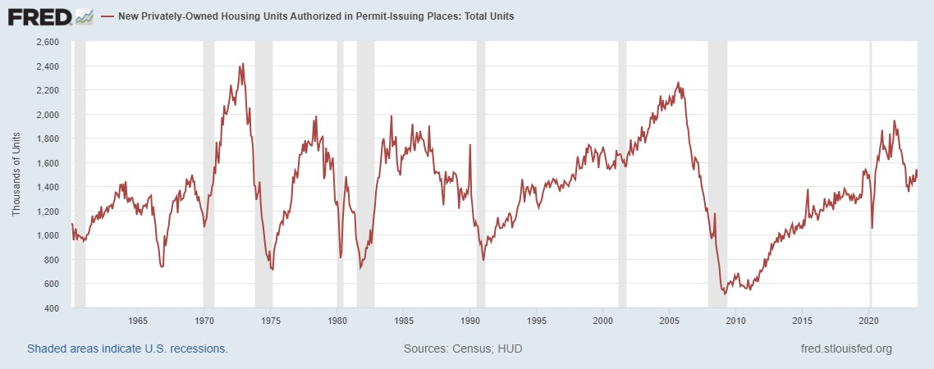

Slide 27
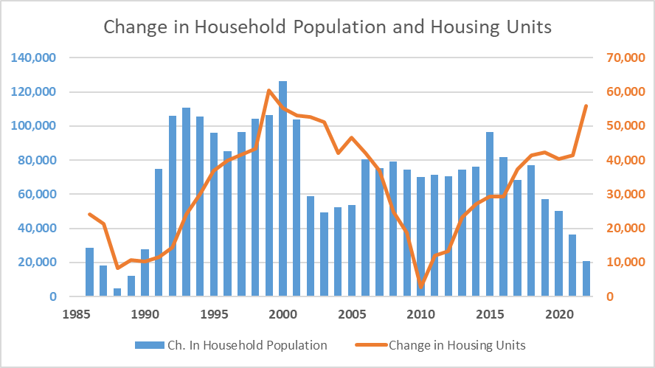
Concern with:
Boom and bust cycle of housing construction.
Creates long run impacts on the industry.
Long run impact on housing costs.
Ability to support business
https://demography.dola.colorado.gov/assets/lookups/county_pop_lookup.html

Slide 28
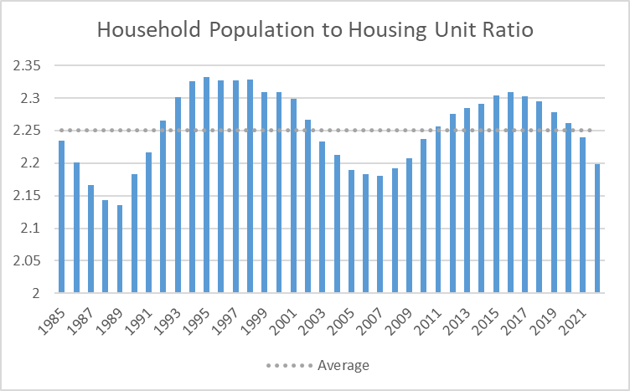
Monitoring Conditions

Slide 29
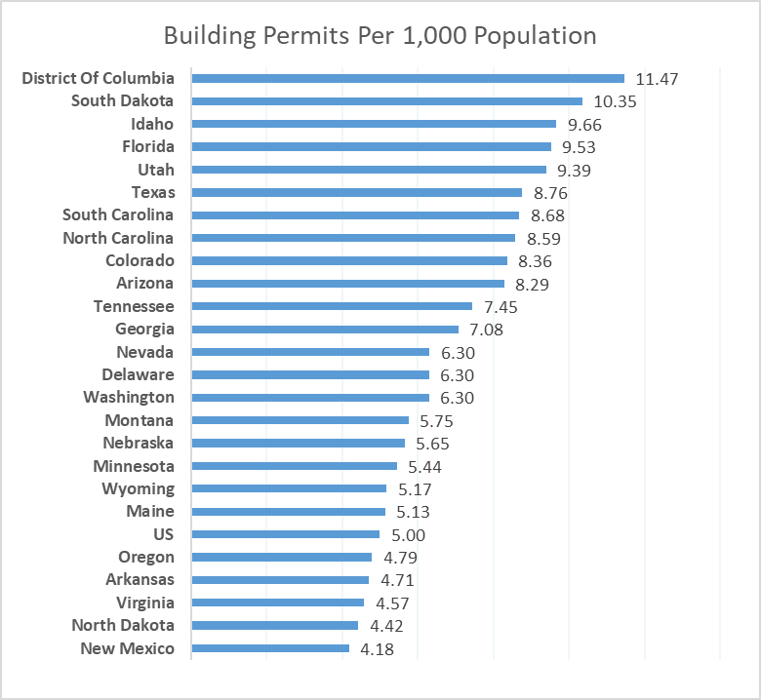
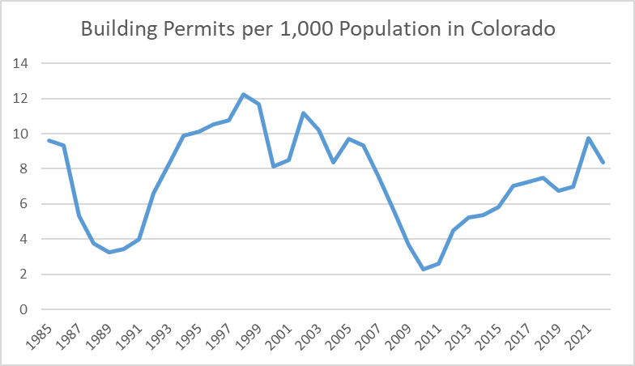
Census Bureau Annual Building Permits, Population Estimates, 2022

Slide 30
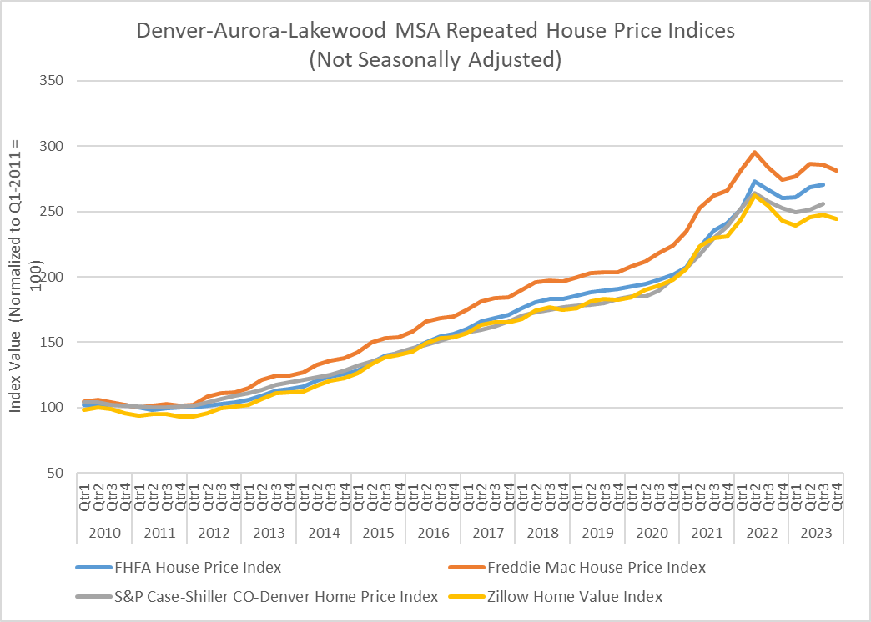
In Q3 2023, Colorado ranked 42nd nationally for home price growth, increasing 1.4% year-over-year in the third quarter. FHFA Home Price Change

Slide 31
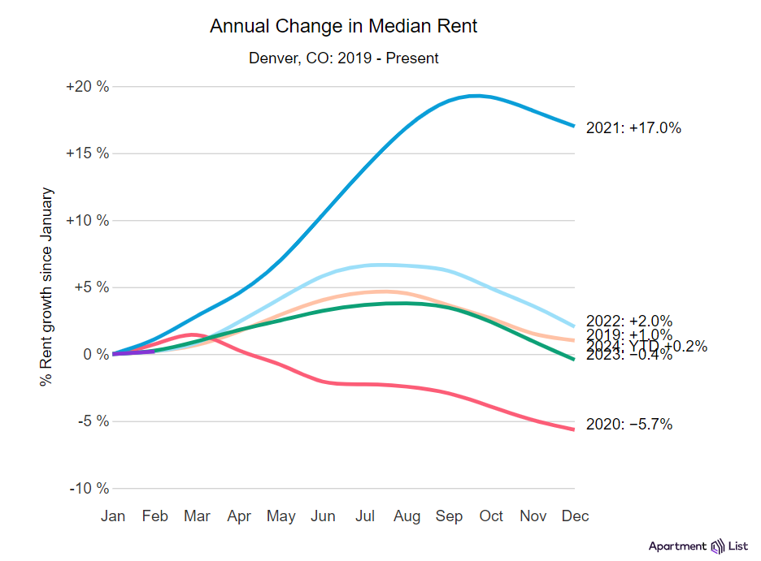
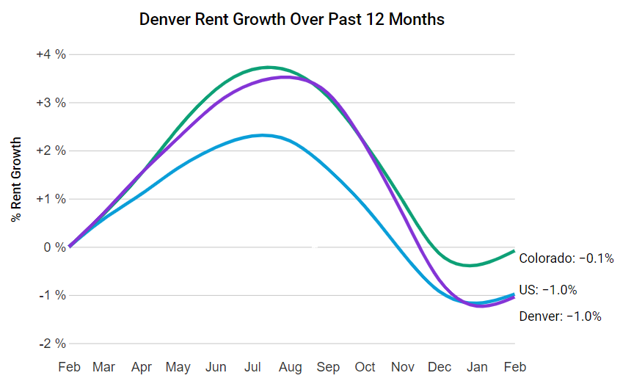
Denver rents went up 0.2% in the past month, compared to the national rate of 0.2%.
Among the nation's 100 largest cities, this ranks #48.
Similar monthly rent growth took place in Kansas City, MO (0.2%) and Albuquerque, NM (0.2%).
Denver is the #23 most expensive large city in the U.S., with a median rent of $1,734.
Denver rents are 1.2% lower than the metro-wide median.
https://www.apartmentlist.com/

Slide 32
Summary: Factors Influencing Housing
Demand
  Job growth = workers = housing
  Aging – smaller household size, non workers
  Household formation rates by age
  Changes in where people live/work - remote
  Investors
Supply
  Built 40K + units per year since 2018
  Interest Rates – downward pressure on building
  Increased cost of construction
  Supply chain and tight labor
  Water, infrastructure
How to soften the Boom and Bust cycle?
How to continue to build when macro factors are not in our favor? Interest rates? labor?
Retrofitting and Renovations – old housing and older residents
How to help people move when macro and demographic factors are against them?
How do we preserve resident owned housing when there is demand by investors and second home owners.
Once interest rates fall, demand will spike again impacting price.
Better research on effective strategies and better public data on housing

Slide 33
Forecast

Slide 34
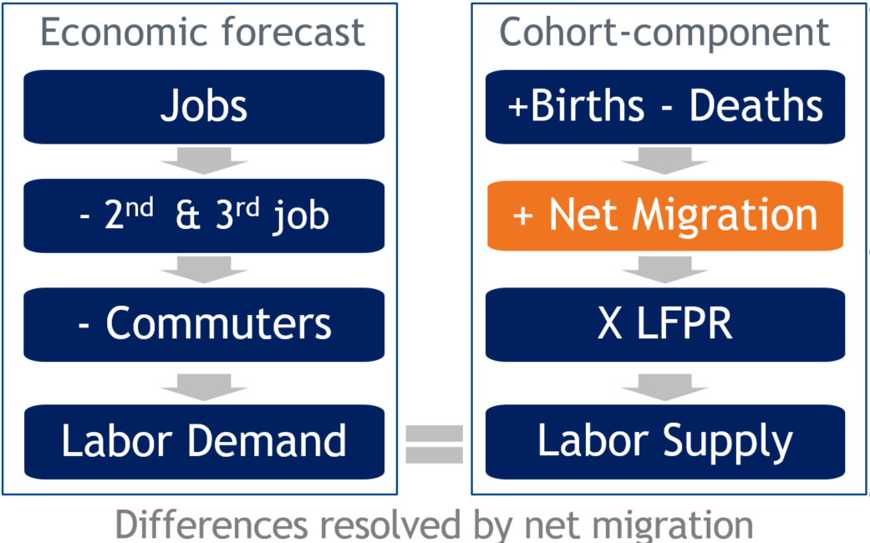
Colorado population forecast methodology

Slide 35
Forecast Factors
US population growth is slowing
Births have slowed, deaths increase
Migration/Mobility slowing, International?
  Tight labor force, Competition to attract and retain workers
Aging –
  400K expected to retire this decade
  Drives economy – health care, leisure and hospitality
  Move less and smaller household size – competition for housing
Job growth drives migration
  New Jobs + Retirements + Remote workers = demand for housing (if they come)
  2020 Decade annual forecast = 40K + 40K + ?
Housing – demographics, boom and bust cycle, interest rates, money supply, supply chain

Slide 36
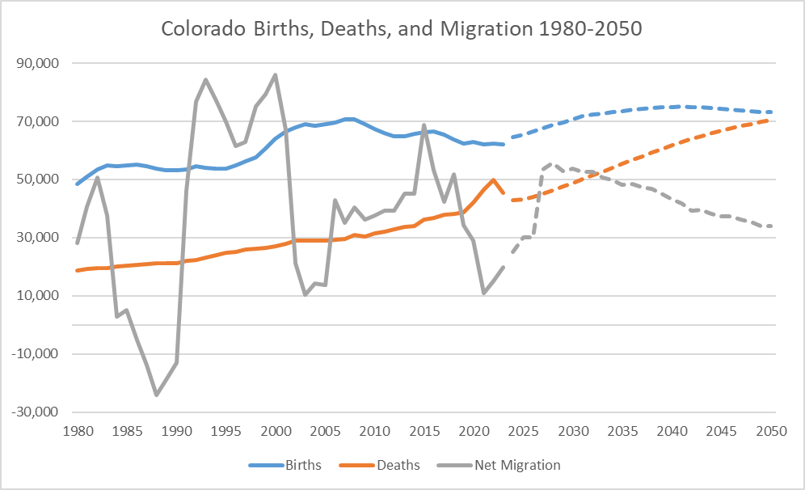
Birth uncertainty
Migration uncertainty

Slide 37
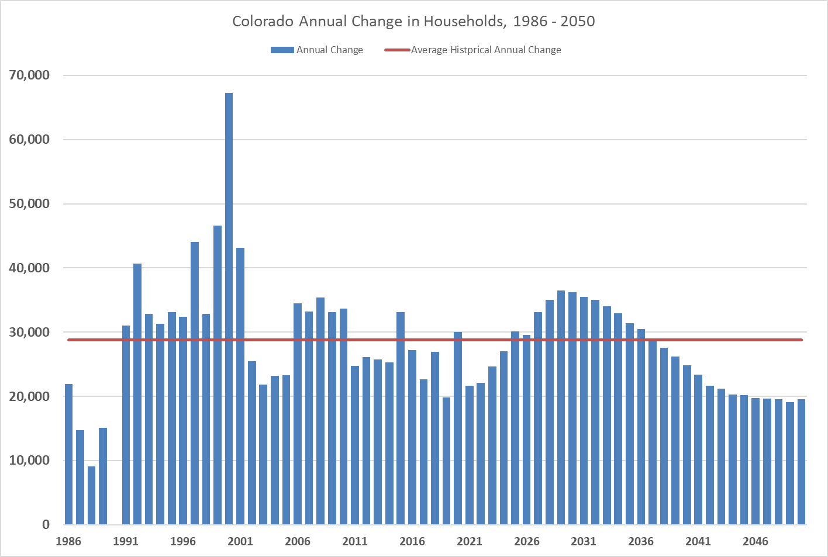
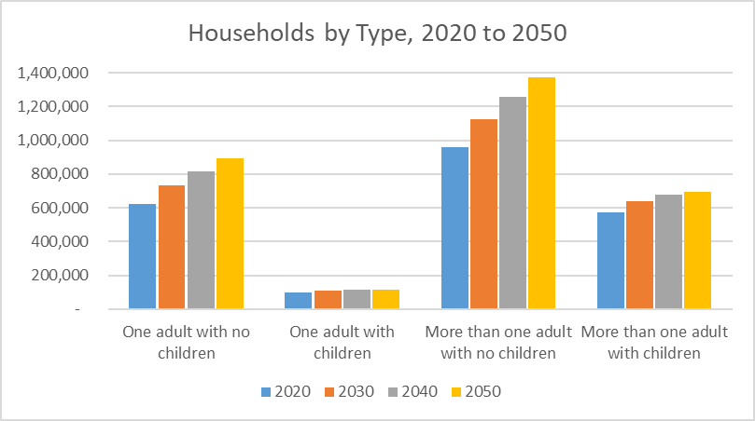
Household Forecast
Age and Migration
Most growth – More than one adult with no children.
Followed by -One adult with no children.
Source: SDO v2022

Slide 38
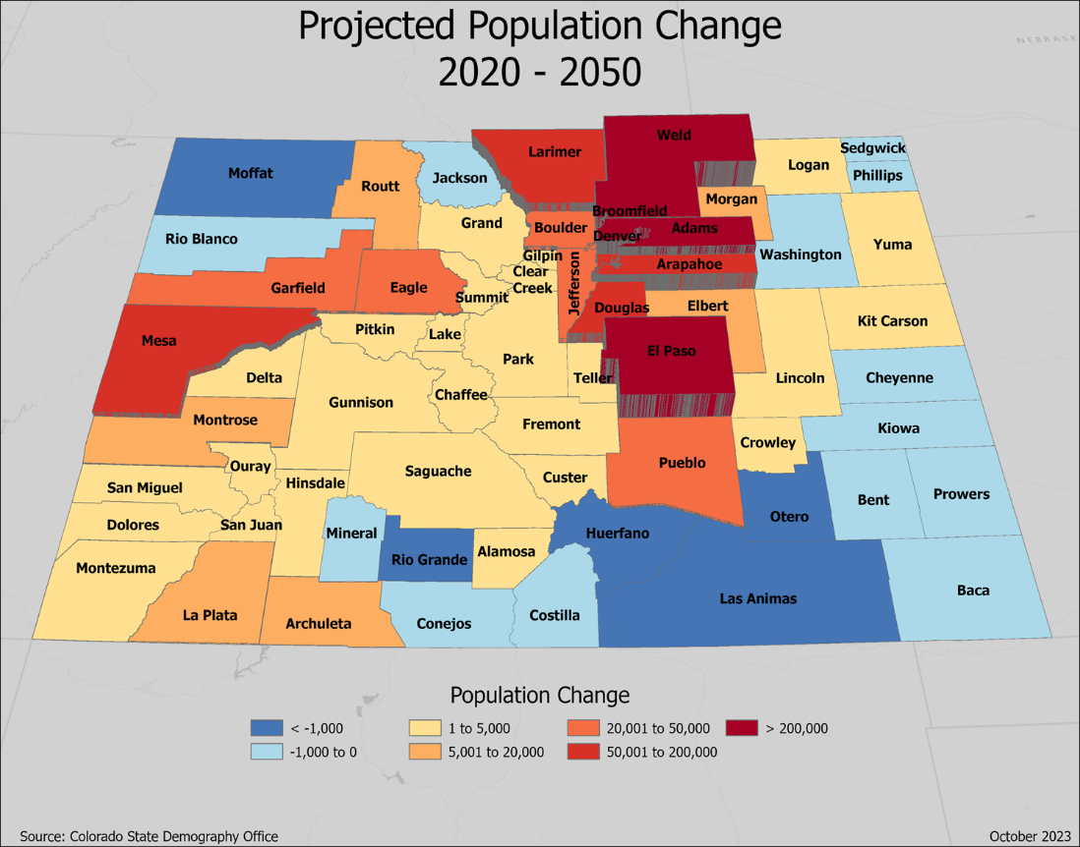
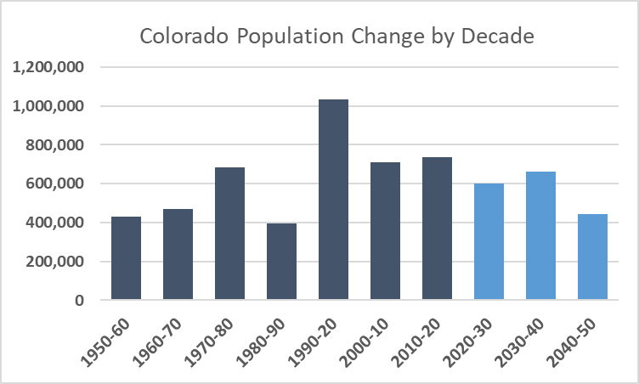
Change 2020-2050
State: 1.7 million
Front Range: 1.49M
Western Slope: 200K
Central Mtns: 4K
San Luis Valley: -2K
Eastern Plains: 11K
5.7 to 7.4 Million

Slide 39
Uncertainties to the Forecast +/-
Intl’ immigration
Water
Housing – supply, price, type, location
Industry changes – boom/bust, competitiveness
Aging – labor force, prepared labor force
Infrastructure/Transportation
Natural disasters - nationally
State Budget

Slide 40
Thank you
State Demography Office
Department of Local Affairs
Elizabeth Garner
Elizabeth.garner@state.co.us
303-864-7750
Demography.dola.colorado.gov

